Slide 1
Breast/Chest Before Bottle
Dr. Kasee Houston
Torrey Albert MSN, RN

Slide 2
Background
Declining skin-to-skin scores
Majority of fallouts were because parents were bottle feeding the baby
Thought: increase in breastfeeding → increase skin to skin contact

Slide 3
What?
Implement a breast/chest before bottle approach to PO feeding for all infants whose mother would like to breast/chest feed
First PO feed should be a breastfeeding/chestfeeding (BF/CF) session before bottle introduction
Standardize gavage volumes for infant’s who are BF/CF and gavage feeding
Already being done at other SCAL KP NICUs (Kaiser OC)
Based on the Infant Driven Feeding Program
Goal is to increase the frequency of BF/CF

Slide 4
Why?
Briere, C. et al. (2016):
Compared to formula fed premature infants, preterm infants on a human milk diet have decreased morbidity and better long-term neurodevelopmental outcomes
Mothers who direct breastfeed (DBF) in the NICU at least once/day were significantly more likely to have continued breastfeeding 1 month post d/c and at 4 months CGA
Pineda, R. (2011)
First oral feeding at the breast is associated with increased frequency of later breast-feeds, increased duration of breast milk feedings and increased success with breast milk feedings at d/c
All mothers in this study who initiated breastmilk feedings but did not DBF, were no longer providing breastmilk for their infant at the time of d/c
Swanson, N. et al. (2022)
DBF as the first oral meal promotes continued breastfeeding during and after hospitalization
Preterm birth is an independent risk factor for early human milk cessation
Clinical practices that result in no DBF result in lower human milk feeding duration
From the parent perspective, DBF has a deep meaning beyond nutritional value
Preterm infants are sensitive to feeding imprinting
Delayed introduction to bottles increases DBF in the hospital and at d/c

Slide 5
Who?
All infants greater than or equal to 33 weeks gestation who are born or transferred to MVMC
All infants who have parents who would like to BF/CF
Exclusion criteria:
Infants who are hypoglycemic and require initial formula feeding to maintain blood glucose levels
Infants and/or parent who is unable to BF/CF due to physical or mental contraindications
Infants of parents who do not wish to BF/CF

Slide 6
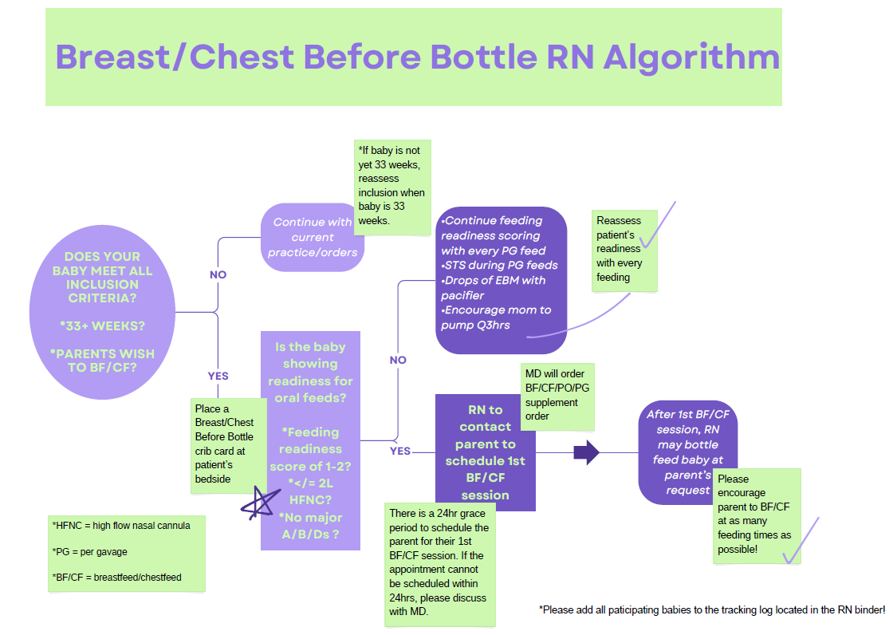
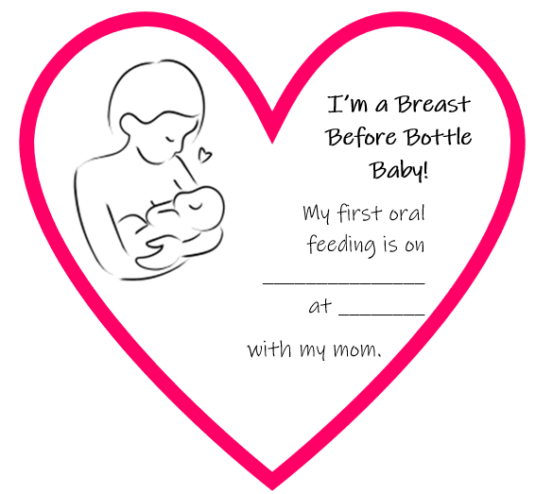
How?

Slide 7
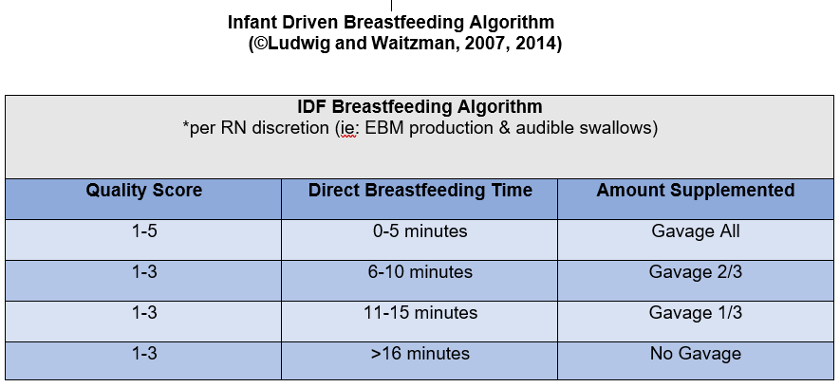
IDF Breastfeeding Algorithm Proposed standardized gavage volumes for PO/PG patients who are BF/CF
*Each BF/CF session is to be observed and scored by the RN. Quality Score based on IDF Quality Scale (see next slide)

Slide 8
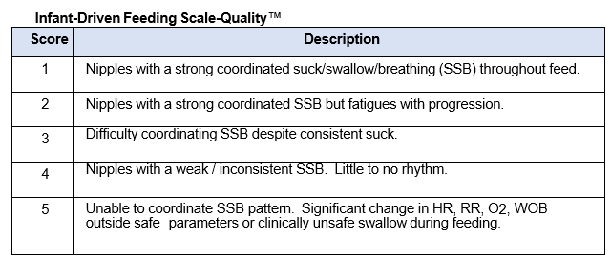
Infant-Driven Feeding Scale - Quality

Slide 9
IDF Breastfeeding Algorithm and IV+PO
Suggestion for infants who have IV+PO:
IV+PO would be calculated off the volume that was gavaged
Example: Baby A’s full feeding volume is 30ml but breastfed well for 8 minutes. According to IDF, baby would be gavaged 2/3 of feed (20 ml). IV+PO would then calculated based on the 20ml gavaged.

Slide 10
How will we measure success?
Improved skin-to-skin metric – majority of our fallouts are due to “Parent Preference” with bottle feeding
2024: Jan 69%, Feb 79%, Mar 82%, Apr 48%, May 56%
Regional goal is greater than 85% (STS/FT)
Improved colostrum care metric
2024: Jan 43%, Feb 75%, Mar 67%, Apr 50%, May 71%
Future Plans
Breastfeeding rates at time of discharge
Frequency of breastfeeding sessions during NICU stay
Breastfeeding rates at 2 month and 6 month follow up outpatient
*RNs will also complete a pre and post survey regarding their current practices with breastfeeding in the NICU, their opinions on current breastfeeding practices, and any barriers that they identify for successfully breastfeeding in the NICU

Slide 11
Projected Timeline – Moreno Valley
Education and Pre-Survey: August 2024
Implementation: September 1, 2024
Protocol measurement period: September 2024 – December 2024
RN Post-Survey: January 2025

Slide 12
Projected Timeline – Riverside
Education and Pre-Survey: January 2025
Implementation: February 1, 2025
Protocol measurement period: February 2025 – May 2025
RN Post-Survey: June 2025

Slide 13
RN Education Plan
Pre-survey at August staff meeting
Literature review results, benefits of breastfeeding
Feeding readiness assessment
Breastfeeding quality assessment
Workflow for protocol, standardized gavage volumes
Post-survey

Slide 14
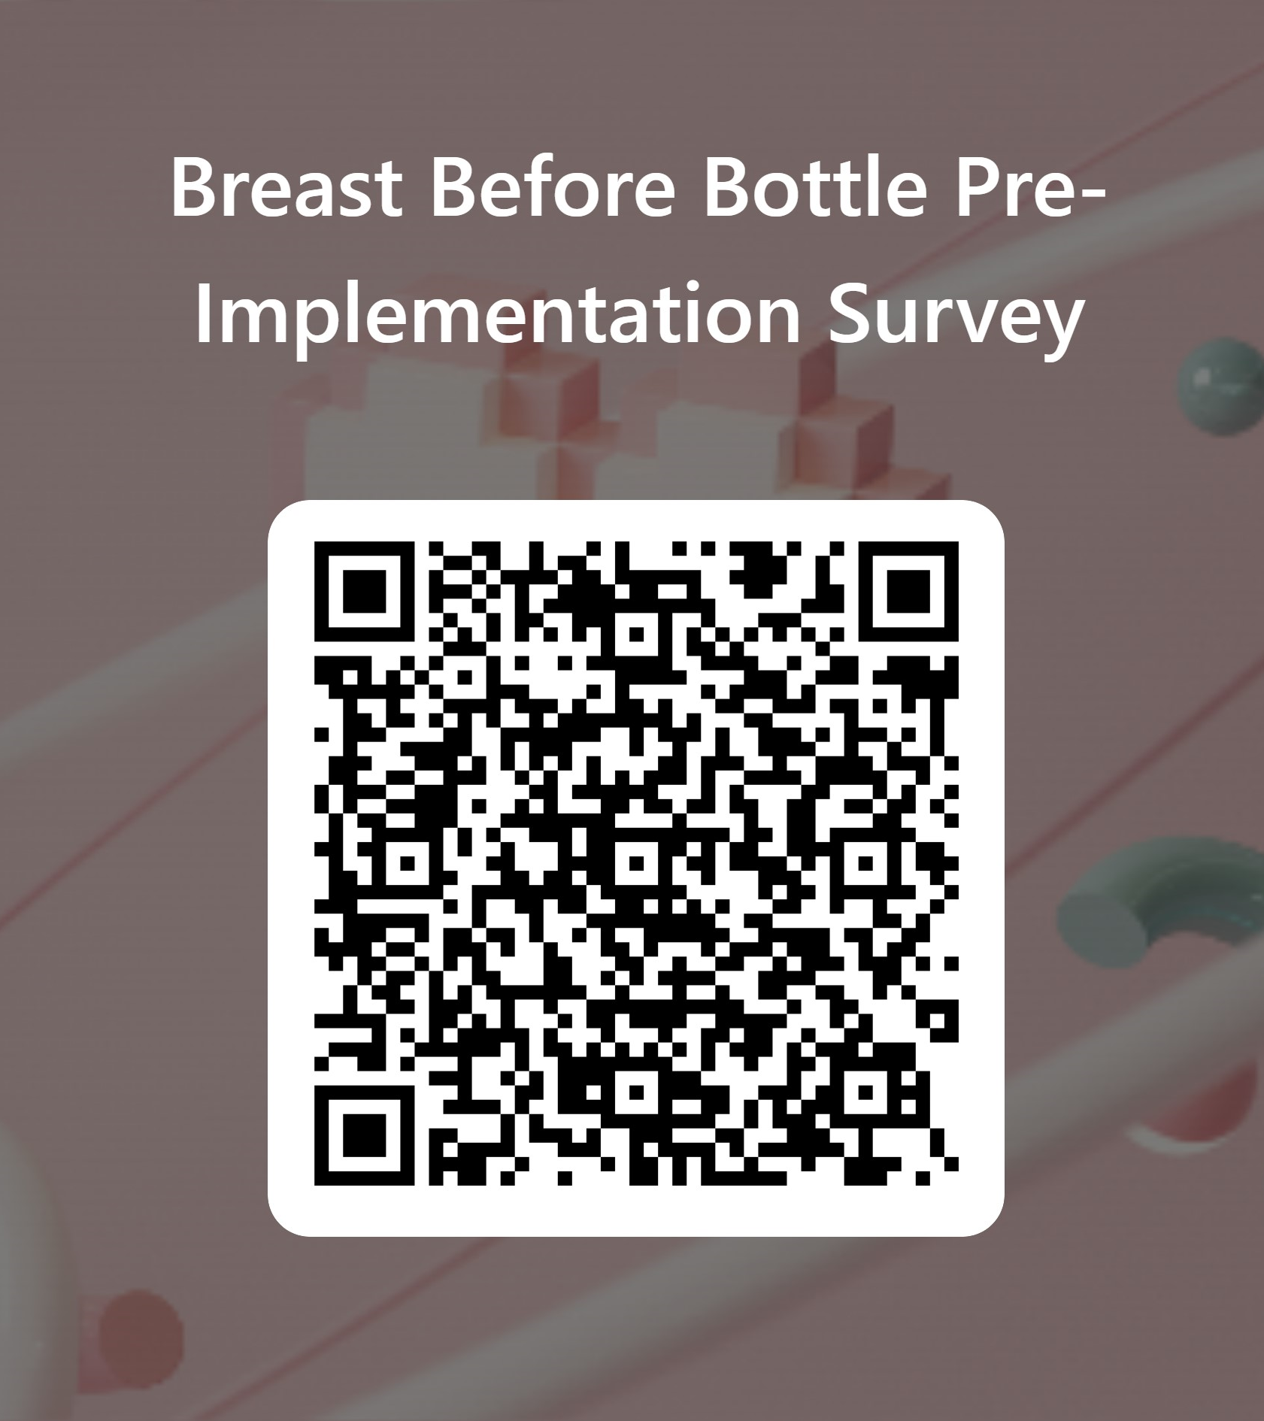
Pre-Implementation RN Survey

Slide 15

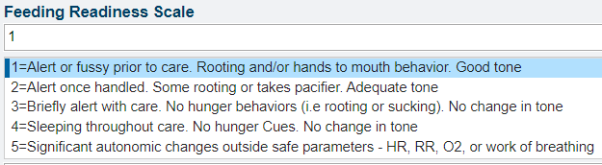
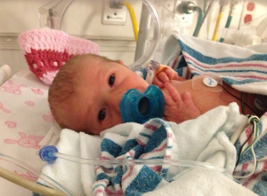
Readiness to Feed Scoring
← Don’t feed me. Let me sleep or do STS!
← Attempt to feed me at breast with mom!

Slide 16
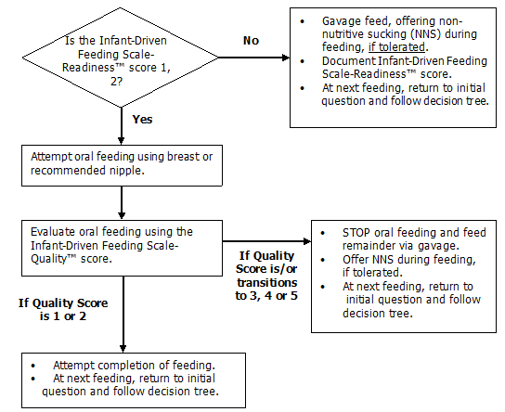
Readiness to Feed Scoring

Slide 17
LATCH Score
L: Latch to mom’s breast
A: Audible swallowing
T: nipple Type
C: mother’s level of Comfort
H: amount of Help

Slide 18
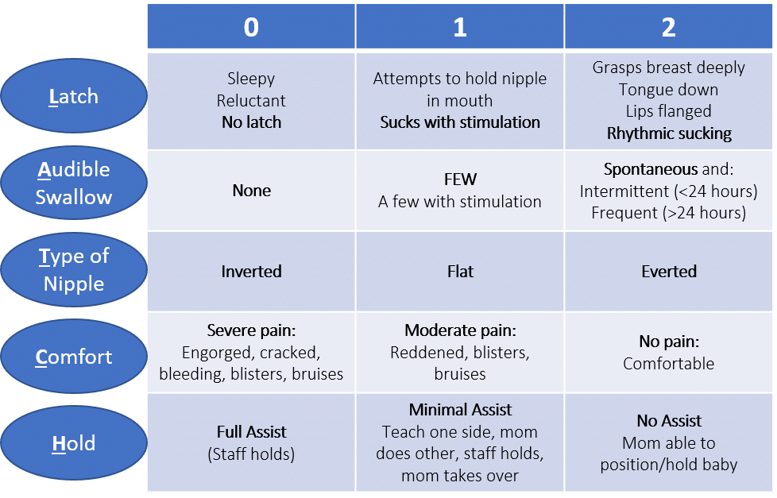
LATCH Score
The RN MUST observe the breastfeeding session!

Slide 19
References
Swanson, N. M., Elgersma, K. M., McKechnie, A. C., McPherson, P. L., Bergeron, M. J., Sommerness, S. A., ... & Harris-Haman, P. A. (2023). Encourage, Assess, Transition (EAT): A quality improvement project implementing a direct breastfeeding protocol for preterm hospitalized infants. Advances in Neonatal Care, 23(2), 107-119. https://doi.org/10.1097/ANC.0000000000001037
Kim, Eun Sook PhD, APN; Min, Hyun Gi APN; Lee, Ji Yeon RN; Lee, Ji Yoon RN; Yi, Young Hee PhD, RN. Development of a Protocol for the Direct Breastfeeding of Premature Infants in Neonatal Intensive Care Units. The Journal of Perinatal & Neonatal Nursing 38(1):p 73-87, January/March 2024. | DOI: 10.1097/JPN.0000000000000791
Ludwig, S.M. & Waitzman, K.A. (2007, September). Changing feeding documentation to reflect infant-driven feeding practice. Newborn and Infant Nursing Reviews, 7(3), 155-160
Briere CE, McGrath JM, Cong X, Brownell E, Cusson R. Direct-breastfeeding premature infants in the neonatal intensive care unit. J Hum Lact. 2015;31(3):386–392. doi:10.1177/0890334415581798.
Pineda, R. Direct breast-feeding in the neonatal intensive care unit: is it important?. J Perinatol 31, 540–545 (2011). https://doi.org/10.1038/jp.2010.205

