Slide 1
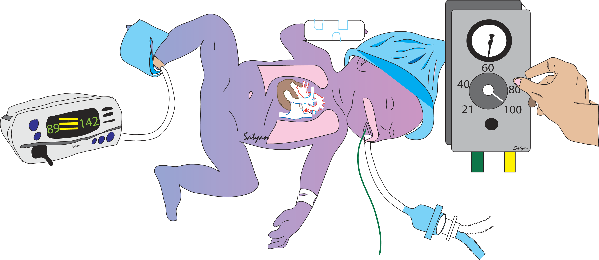
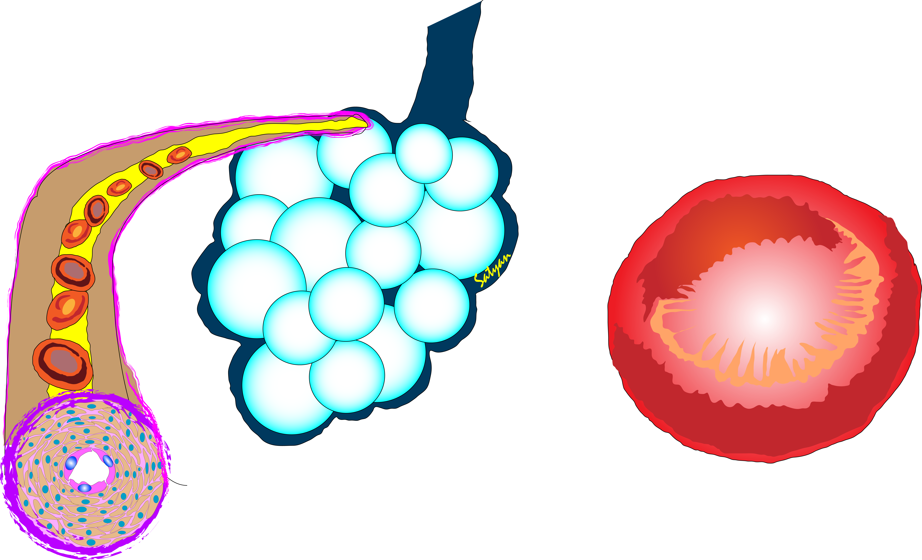

Precision Medicine Approach to
Management of PPHN
Clara H. Song, MD, FAAP
Neonatal Intensivist | Southern California Permanente Medical Group
Chair Elect | American Academy of Pediatrics, Section on Neonatal-Perinatal Medicine
Lean Six Sigma Black Belt
E clara.h.song@kp.org E clarasong@me.com T @songMD
Satyan Lakshminrusimha, MD FAAP
Professor and Chair of Pediatrics,
Pediatrician-in-Chief
University of California-Davis – Children’s Hospital
slakshmi@ucdavis.edu @neosatyan

Slide 2



Disclosures and Objectives
Drs. Song and Lakshminrusimha have no conflicts of interest to disclose
Unapproved uses: Use of iNO is not FDA approved in preterm infants < 34 weeks gestation
Vasopressin and milrinone – not approved in neonates
OBJECTIVES:
Evaluate the role of optimal lung inflation in pulmonary hypertension and hypoxemic respiratory failure
Define ideal oxygen targets in the management of neonatal pulmonary hypertension based on phenotype
Understand the ventilation strategies, surfactant, vasopressor therapy and pulmonary vasodilator therapy in neonatal pulmonary hypertension

Slide 3
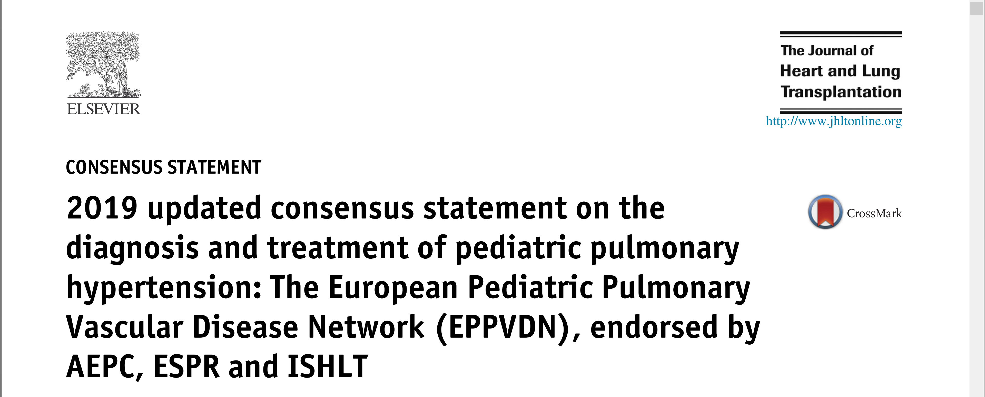
References

Slide 4
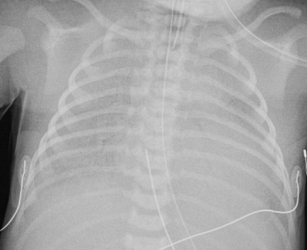
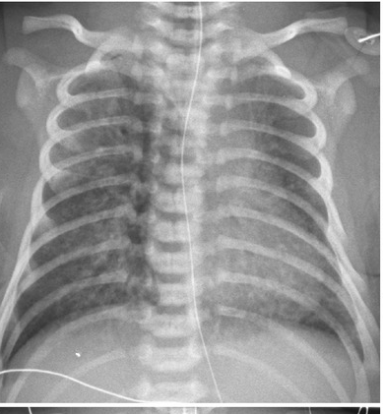
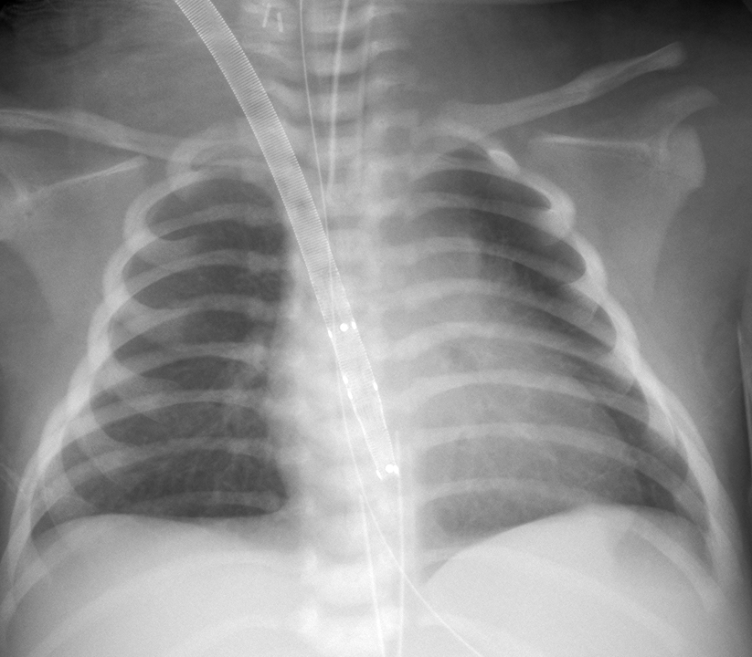
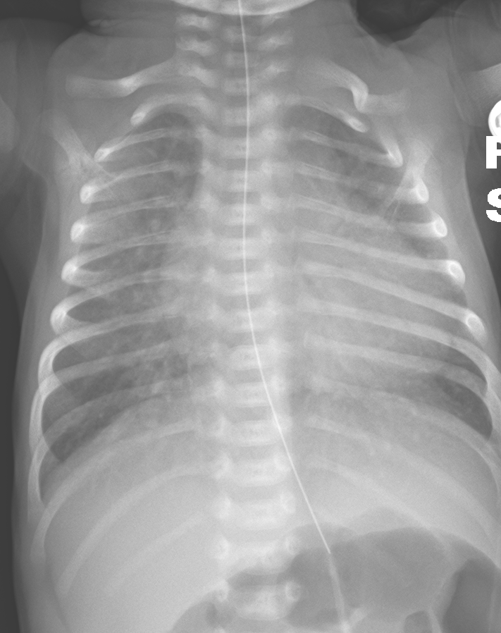
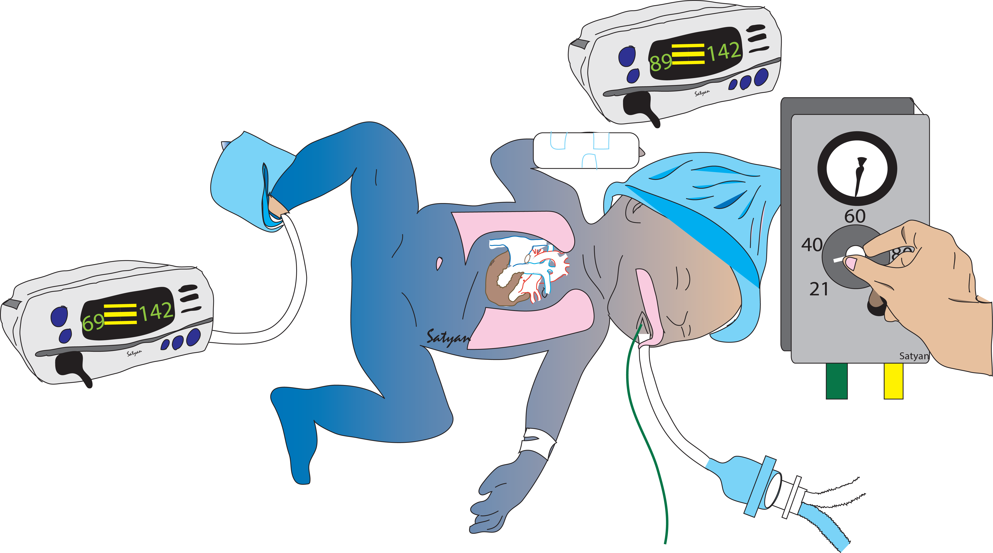
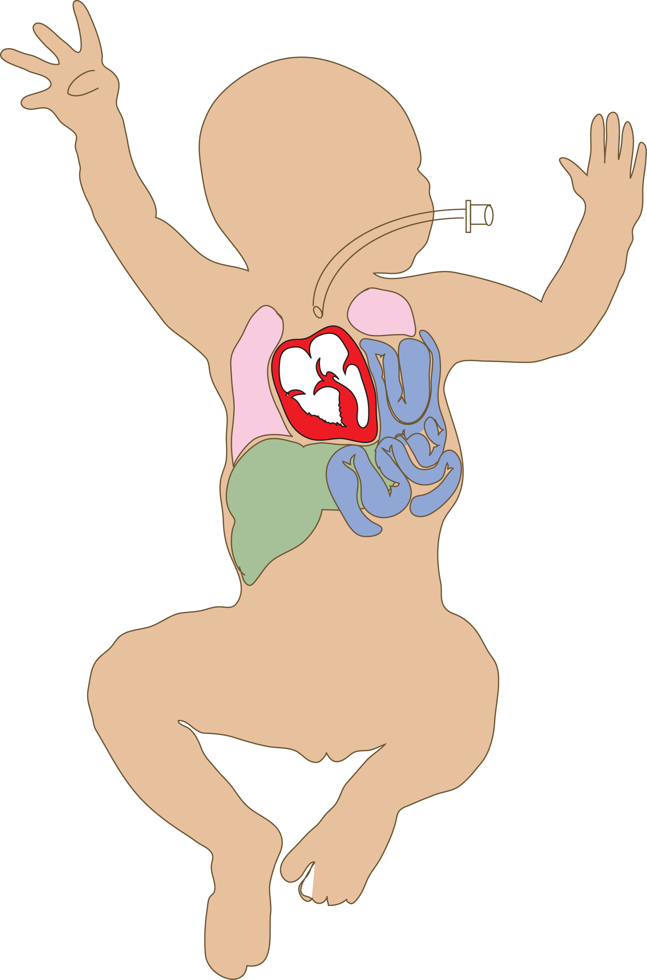
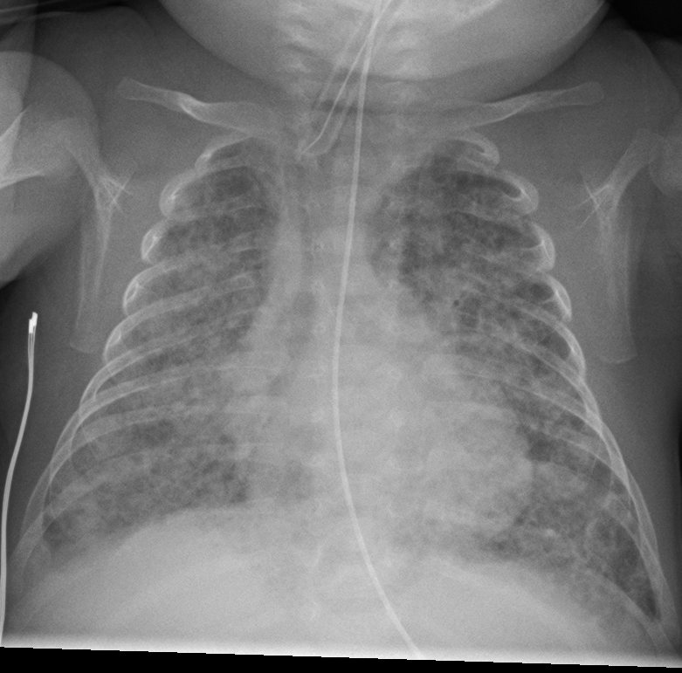
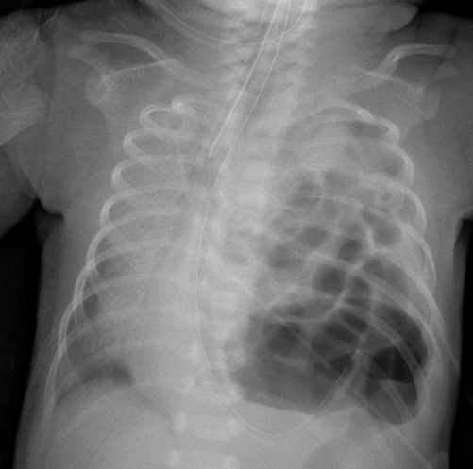
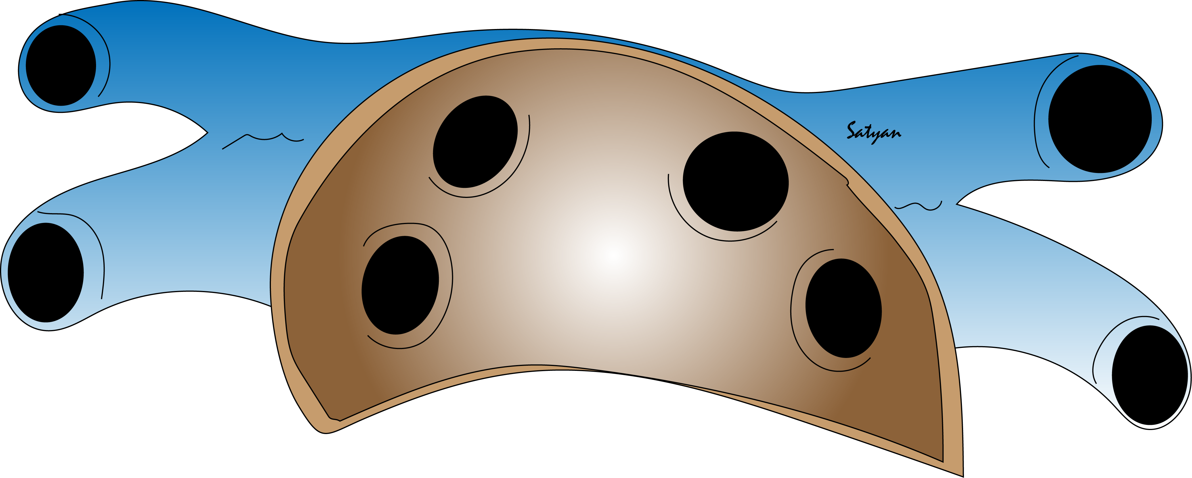
Later onset infection, hypothermia or cardiac disease induced acute pulmonary hypertension
Acute PPHN in term, late preterm and post-term neonates due to poor transition
e.g., HIE, pneumonia, MAS, RDS or Idiopathic
Acute, Early pulmonary hypertension in extremely preterm infants (PPHN physiology)
CDH – both acute and chronic pulmonary hypertension
Acute Pulmonary Hypertension of the Neonate (aPHN)
Spectrum of Pulmonary Hypertension in the NICU
Chronic, late pulmonary hypertension with BPD (BPD-PH)
Pulmonary vein stenosis (PVS
Chronic Pulmonary Hypertension
Notes:
Inset acute PPHN – MAS and idiopathic PPHN with VV ECMO on day 1. Enterococcus fecalis in trach aspirate

Slide 5
Phenotypes of Neonatal Pulmonary Hypertension
iNO usually effective
iNO can ↑ Qp further
iNO can ↑ PCWP and ↑ pulmonary edema

Slide 6

Case: Term MSAF
C
39-week gestation baby girl
MSAF – no tracheal suction
Limp at birth: cord management?
Immediate cord clamping
Delayed cord clamping 60 seconds
Intact umbilical cord milking
Cut umblilical cord milking

Slide 7
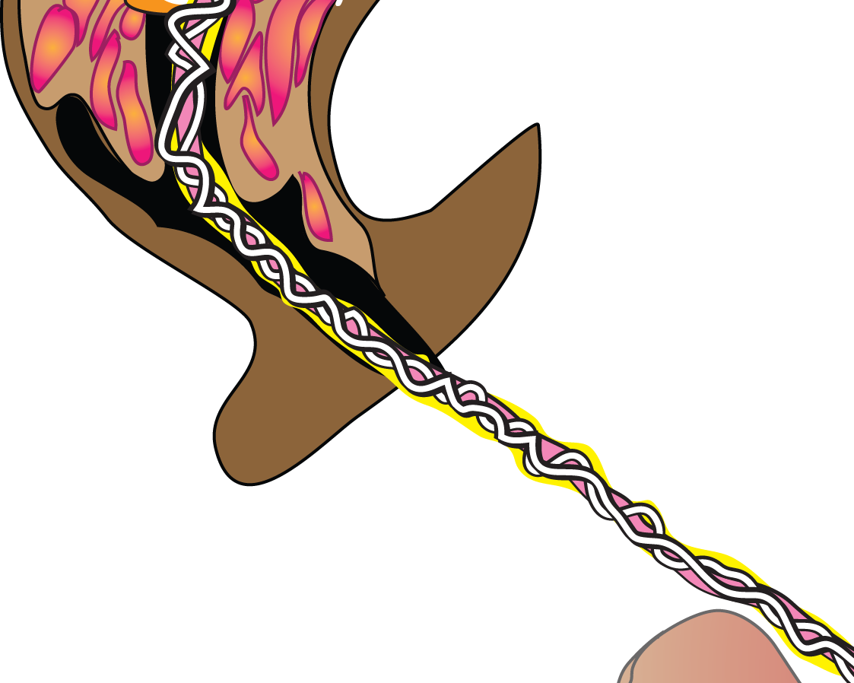
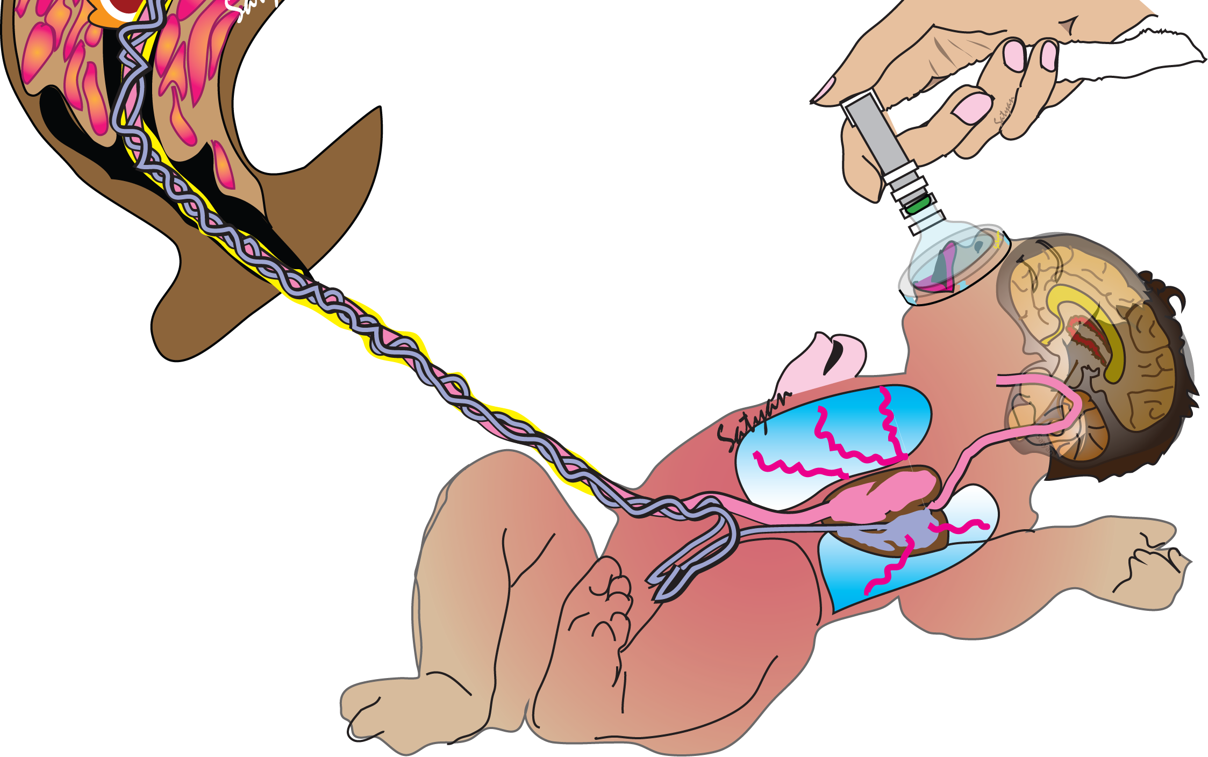
Intact cord milking?

Slide 8
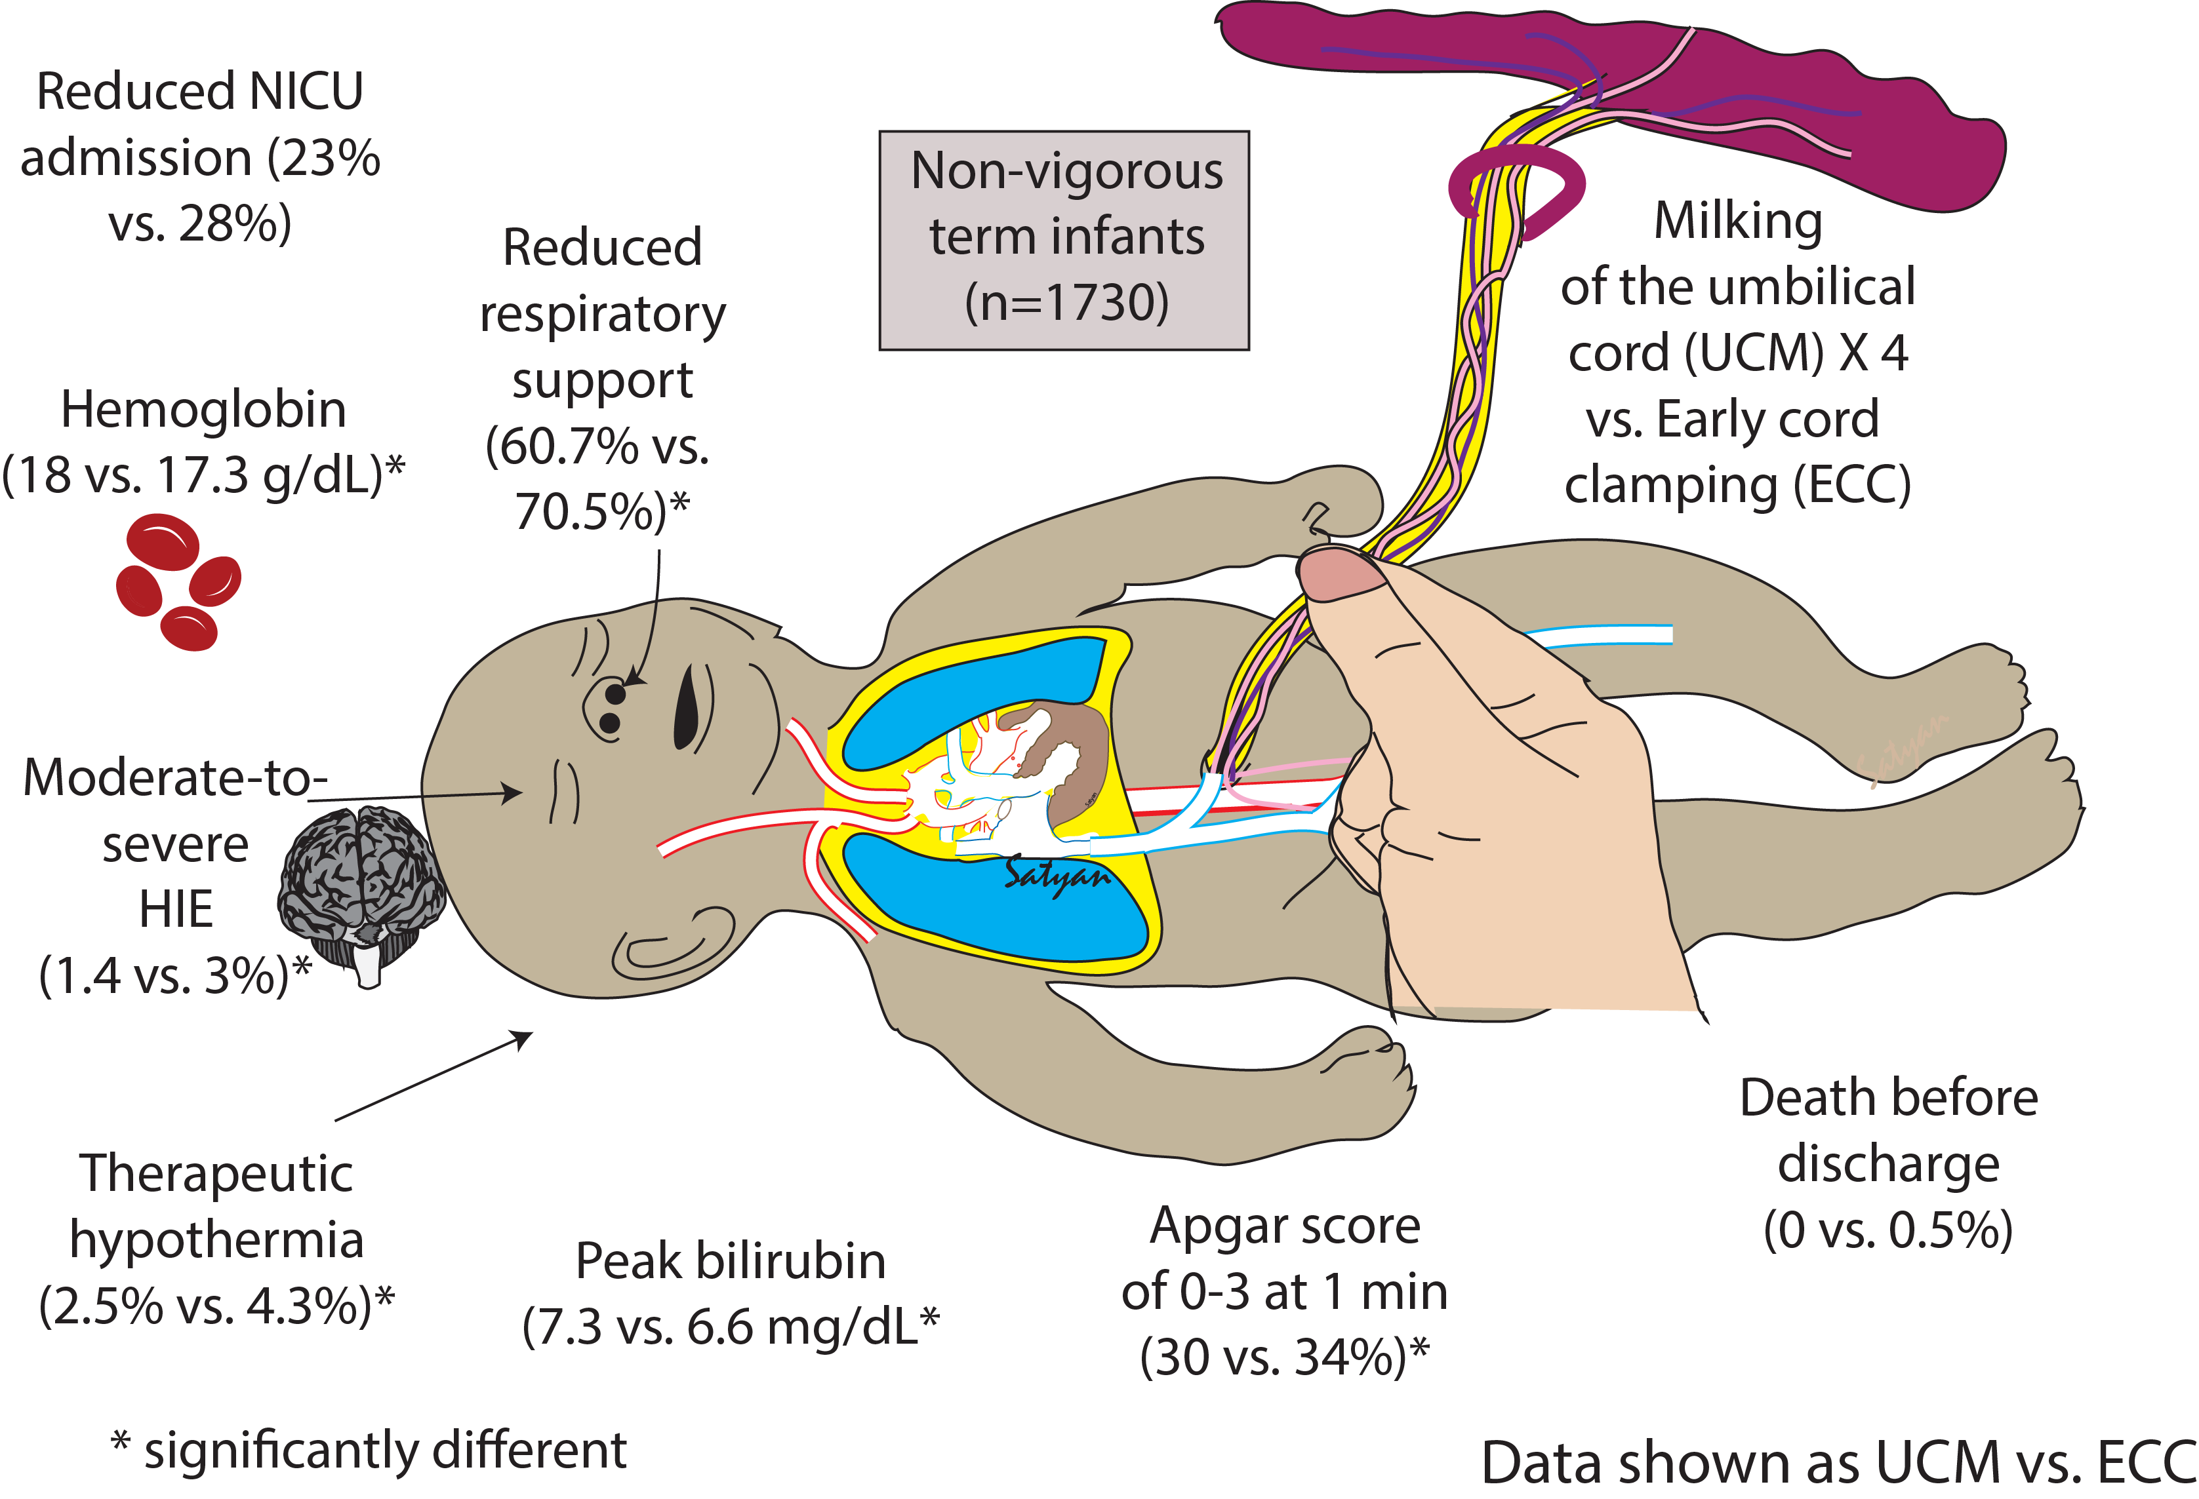
Term Non-Vigorous Babies – Cord Milking ↓ HIE/TH
Katheria AC, Clark E, Yoder B, et al. Umbilical cord milking in nonvigorous infants: a cluster-randomized crossover trial. American journal of obstetrics and gynecology. 2023;228(2):217 e211-217

Slide 9
Term Non-Vigorous: Cord Milking ↑ RVO/LVO /↓FiO₂
Katheria A, Mercer J, Poeltler D, et al. Hemodynamic Changes with Umbilical Cord Milking in Nonvigorous Newborns: A Randomized Cluster Cross-over Trial. The Journal of pediatrics. 2023;257:113383.
Katheria AC, Law BHY, Poeltler D, et al. Cardiac and cerebral hemodynamics with umbilical cord milking compared with early cord clamping: A randomized cluster crossover trial. Early human development. 2023;177-178

Slide 10
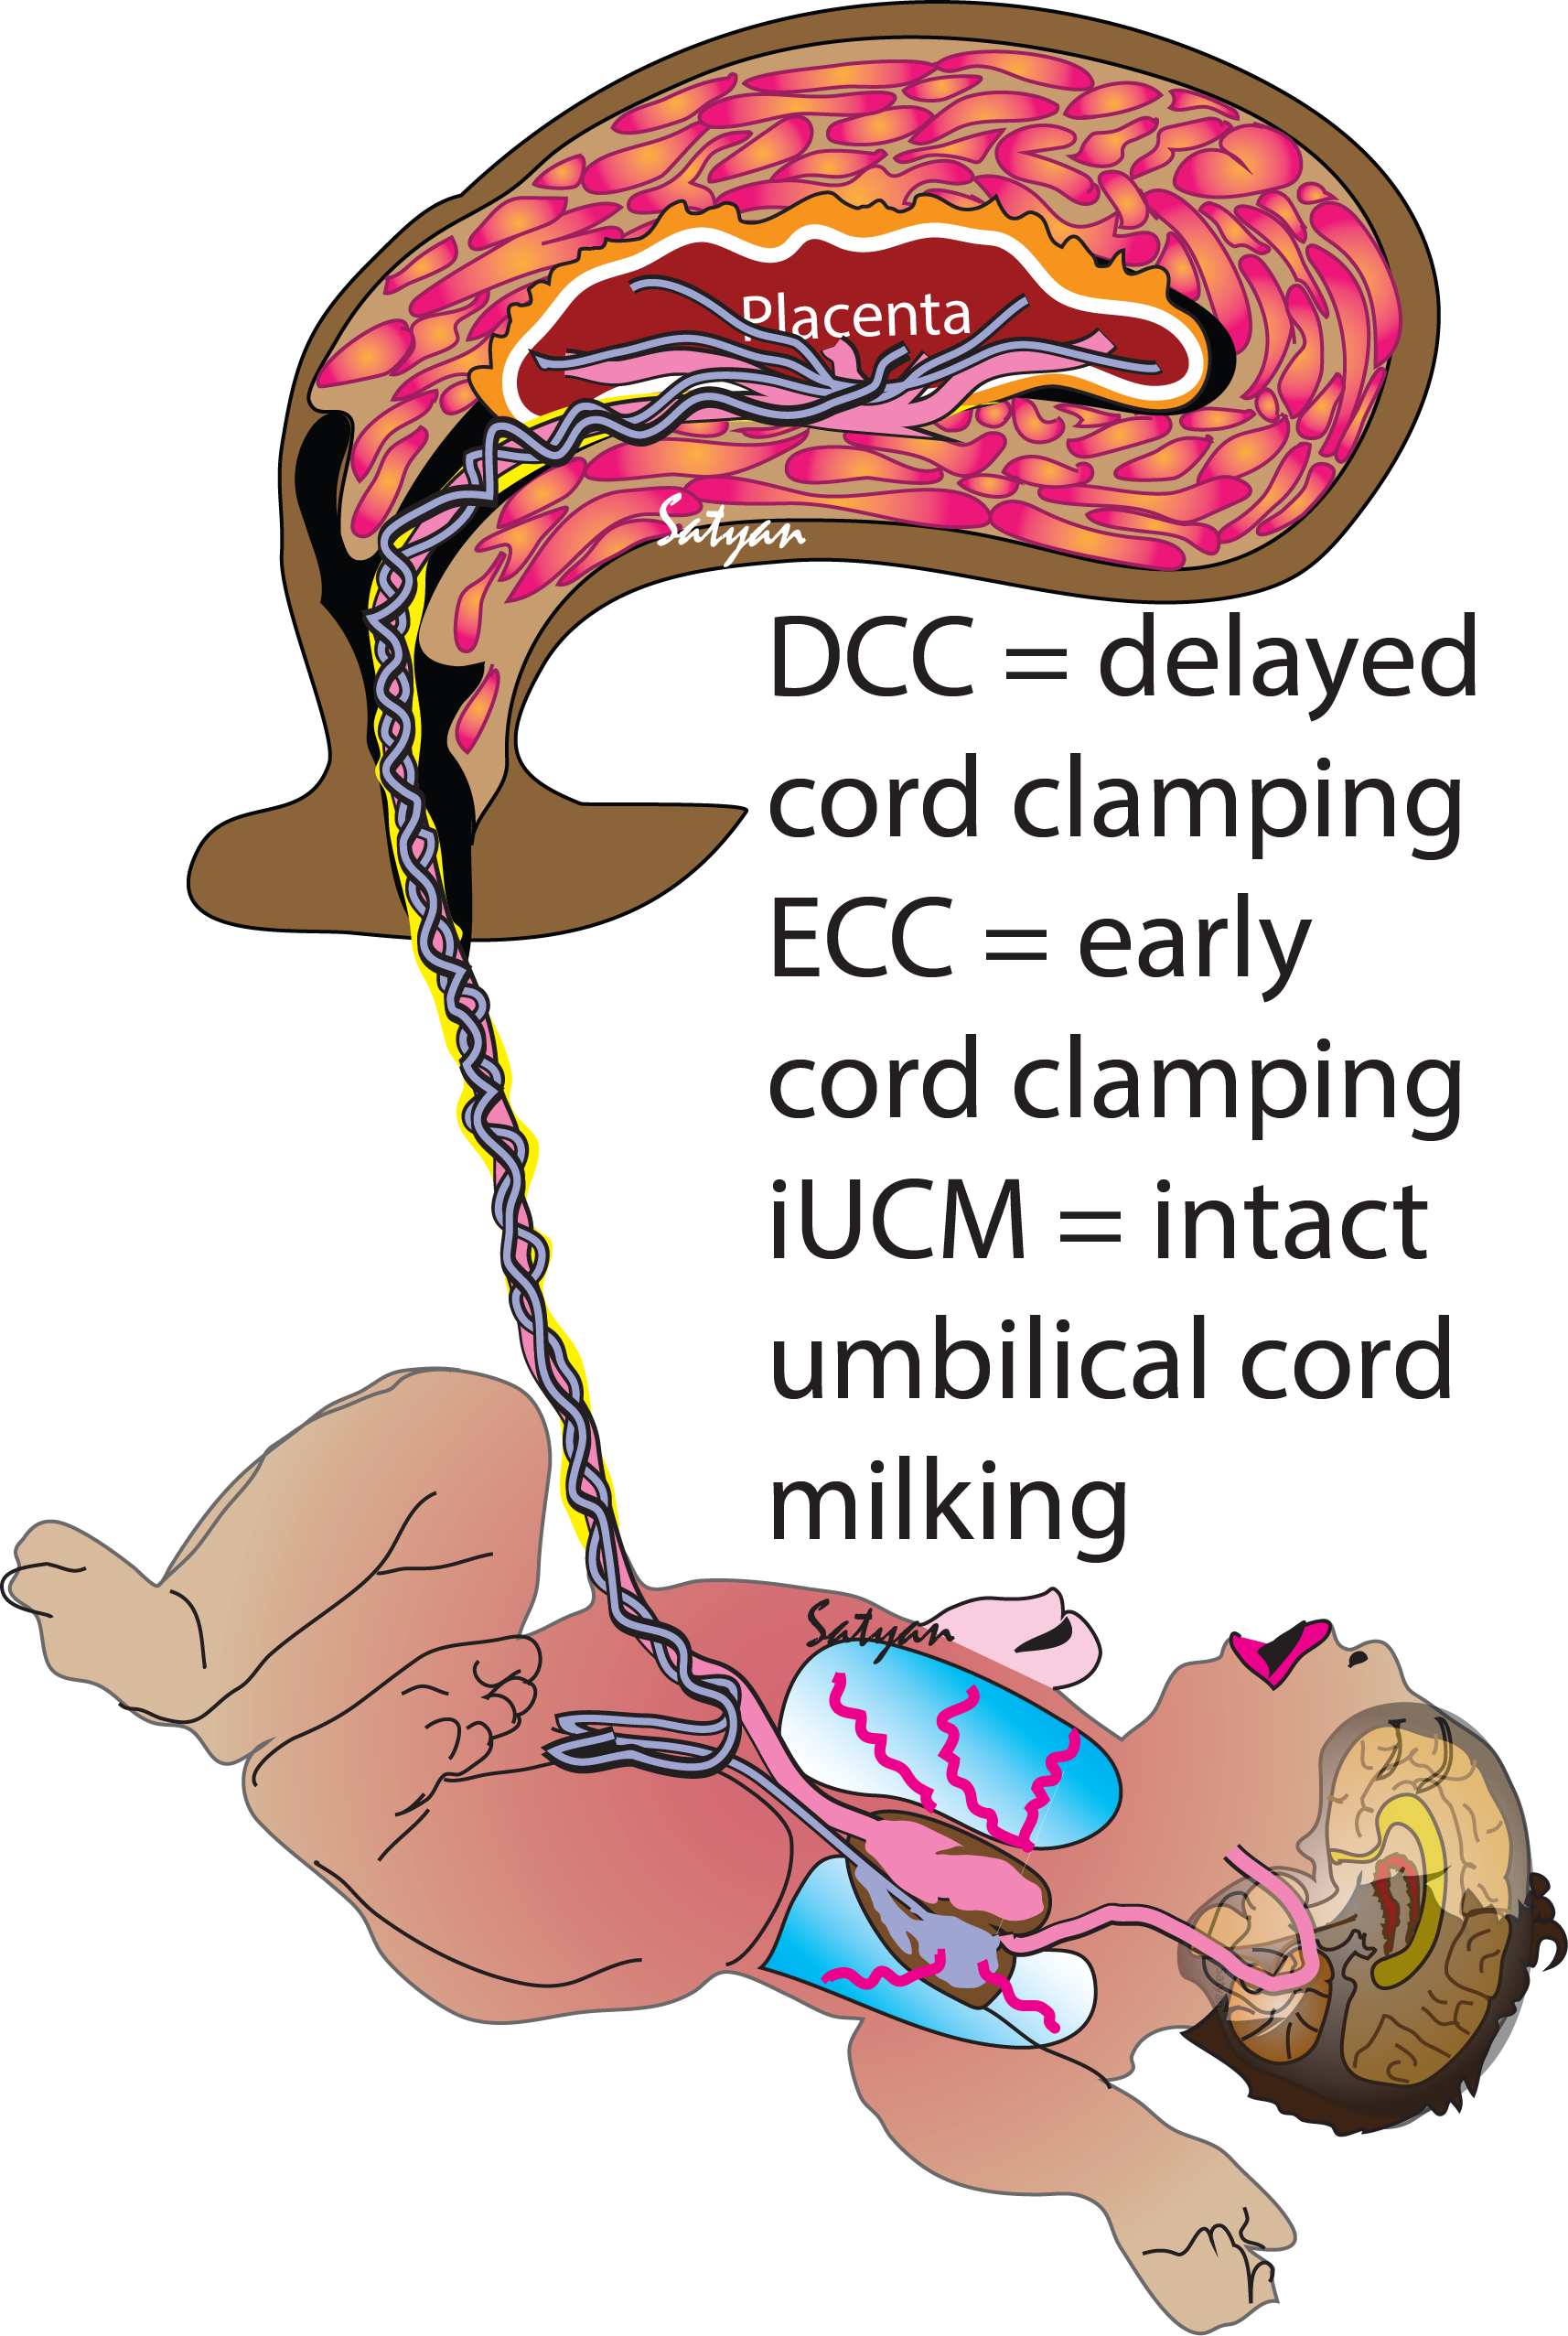
Umbilical Cord Management
Gestational age | < 28 weeks | 28-34 weeks | > 34 weeks
No resuscitation needed | DCC ≥ 30s can be beneficial compared to ECC < 30s
Resuscitation needed |  |  | Non-vigorous 35-42 weeks, iUCM may be reasonable compared to ECC < 30s
iUCM not recom-mended
iUCM not known to be beneficial compared to DCC ≥ 30 s
iUCM may be reasonable if DCC cannot be performed

Slide 11
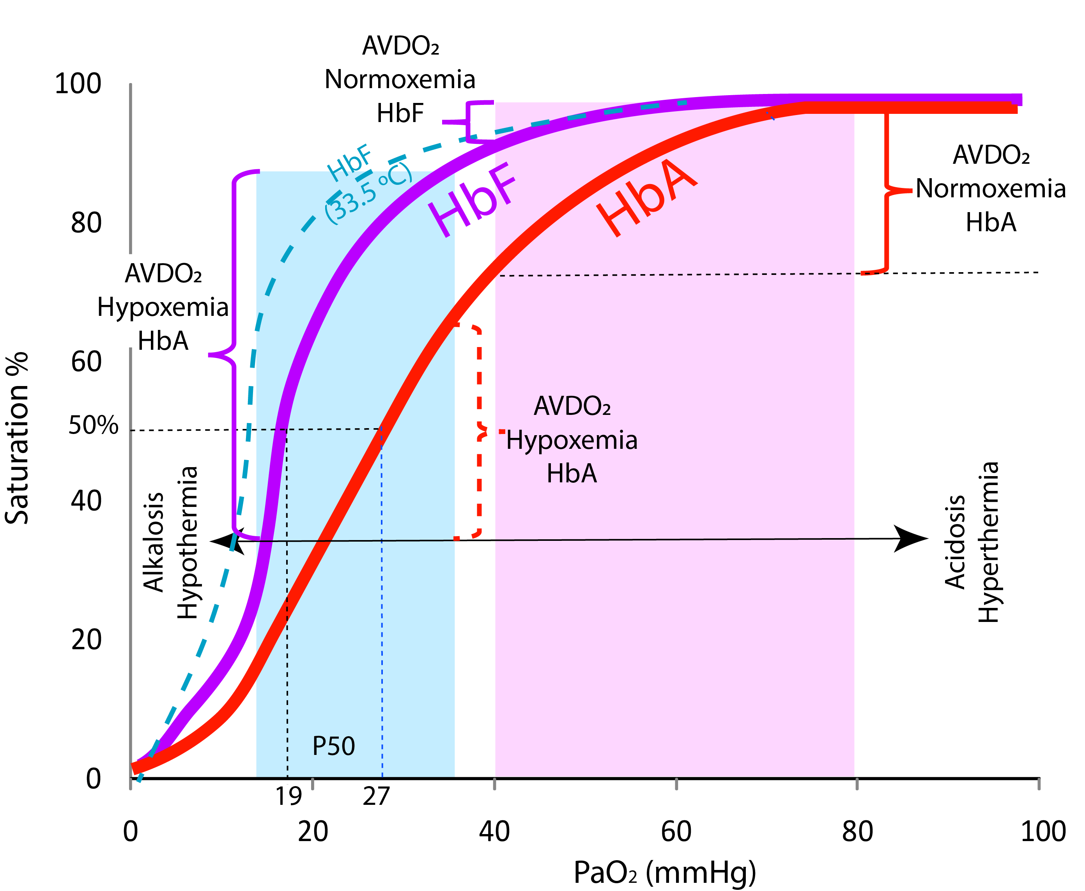
Unique Aspects of Fetal Hemoglobin:
More effective during hypoxemia

Slide 12
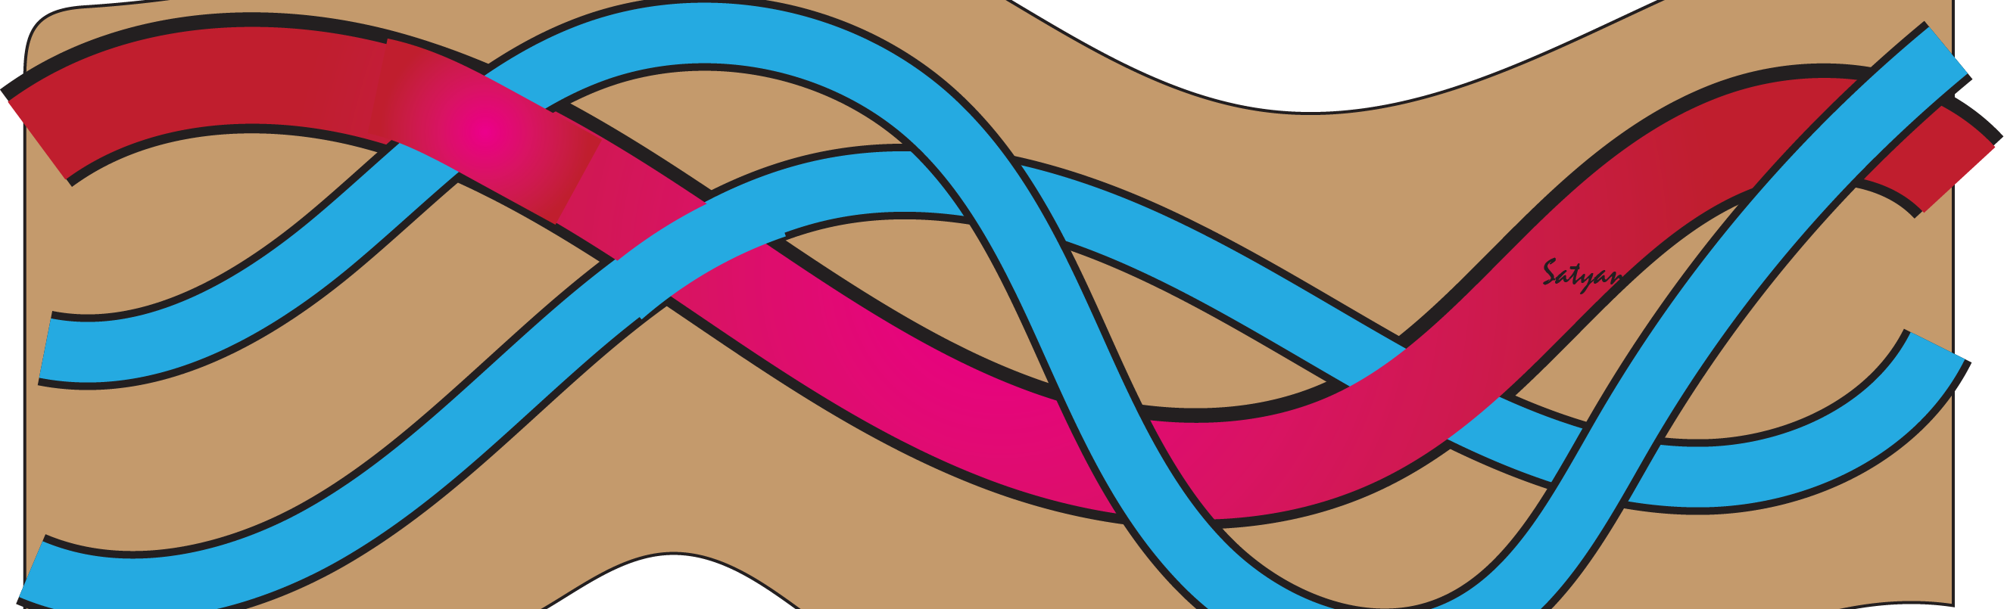
Cord Blood Gases
C
Cord Gases:
Art: 6.9/74/27/15/-19
Ven: 7.2/45/32/-14
Cord compression (partial)
Placental abruption
Complete cord compression
Sampling error

Slide 13
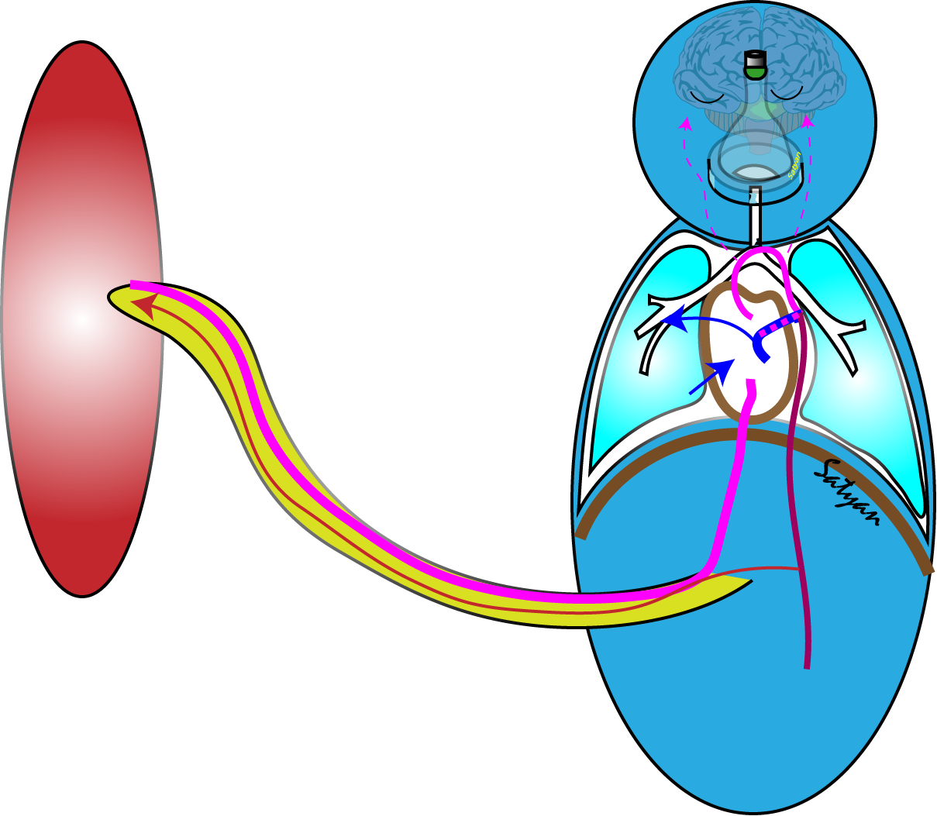

Interpretation of Cord Gases: Partial compression
C
UA gas PaO₂ is usually < 38 mmHg
Umbilical Cord Gas:
Art: 6.9/74/27/15/-19
Ven: 7.2/45/32/-14
UV gas reflects placental gas exchange
UA gas pH is at least 0.15 units lower than UV
UA gas reflects infant’s status
Armstrong and Stenson Use of umbilical cord blood analysis in the assessment of the newborn Arch Dis Child 2007

Slide 14
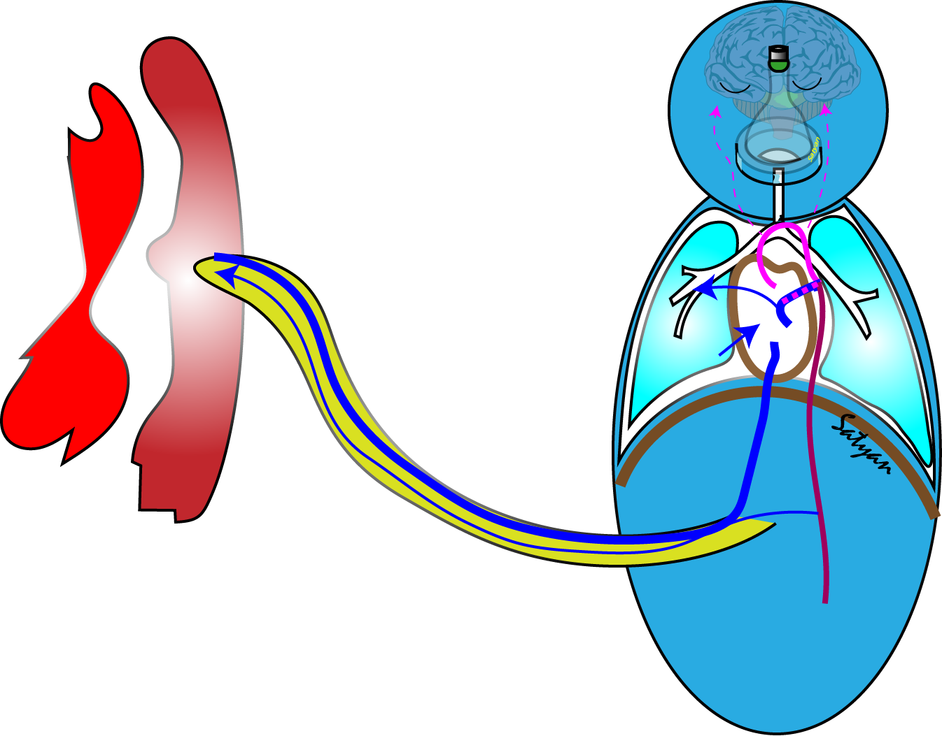

Interpretation of Cord Gases:
Abruption or Uterine Rupture
C
Umbilical Cord Gas:
Art: 6.9/74/27/15/-19
Ven: 6.95/70/22/-15
UA gas pH is < 0.15 units lower than UV
Armstrong and Stenson Use of umbilical cord blood analysis in the assessment of the newborn Arch Dis Child 2007

Slide 15

Interpretation of Cord Gases: Acute, total compression
C
Umbilical Cord Gas:
Art: 7.26/52/21/-3.7
Ven: 7.34/47/22/-1
Baby’s first gas-6.9/74/27/15/-19
“Compartmentalization” of the baby from placenta
Armstrong and Stenson Use of umbilical cord blood analysis in the assessment of the newborn Arch Dis Child 2007

Slide 16
Interpretation of Cord Gases: Sampling Error
C
Umbilical Cord Gas:
Art: 7.33/48/21/-1.5
Ven: 7.34/47/22/-1
Baby’s first gas-6.9/74/27/15/-19
Arterial tap is more difficult than UV sampling
Armstrong and Stenson Use of umbilical cord blood analysis in the assessment of the newborn Arch Dis Child 2007

Slide 17

Blood Gases with Hypocarbia and Hyperoxia
C
Umbilical Cord Gas:
Art: 6.9/74/27/15/-19
Ven: 7.4/19/82/-12
Air bubbles:
PCO₂ ~ 0
PO₂ – 150 mmHg

Slide 18
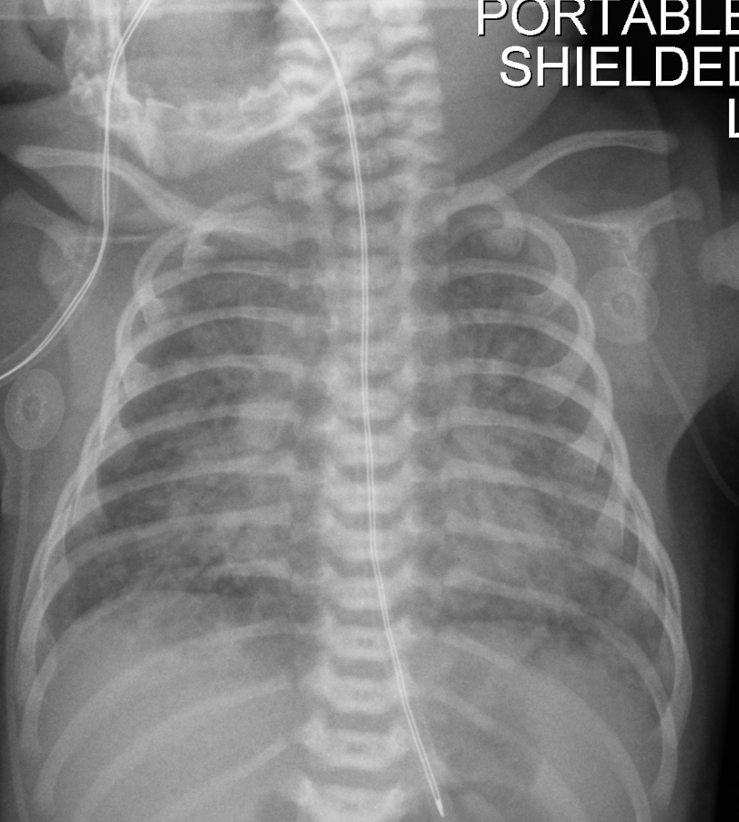
Case – Meconium Happens!
C
MSAF at delivery- infant floppy and apneic required PPV
Infant transferred to NICU on 60% O₂
NIV on admission, FiO₂ increasing to 1.0
At 2 h, Conventional vent – PEEP-5, rate- 40/min Vt – 5 ml/kg, 90% O₂ MAP-12
Blood gas (UA): 7.17/20/124/7/-19

Slide 19
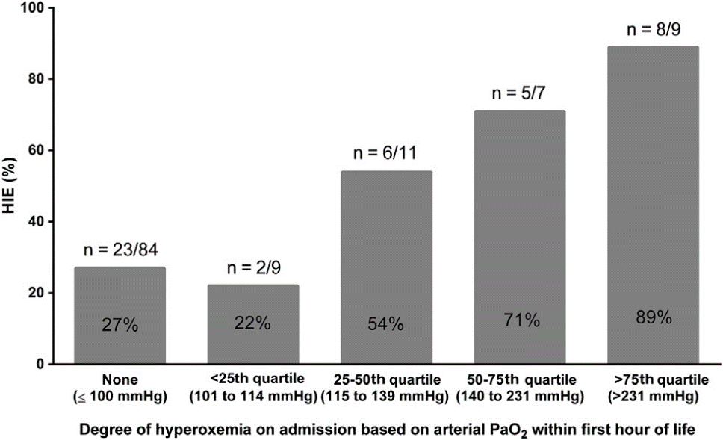
Immediate Post-resuscitation Period Hyperoxia
(PaO₂>115 mmHg) following Perinatal Distress
Upper limit:
Increased risk of HIE > 115 mmHg
Perinatal Asphyxia
Postnatal hyperoxia
↑ HIE
Kapadia et al J Peds 2013

Slide 20
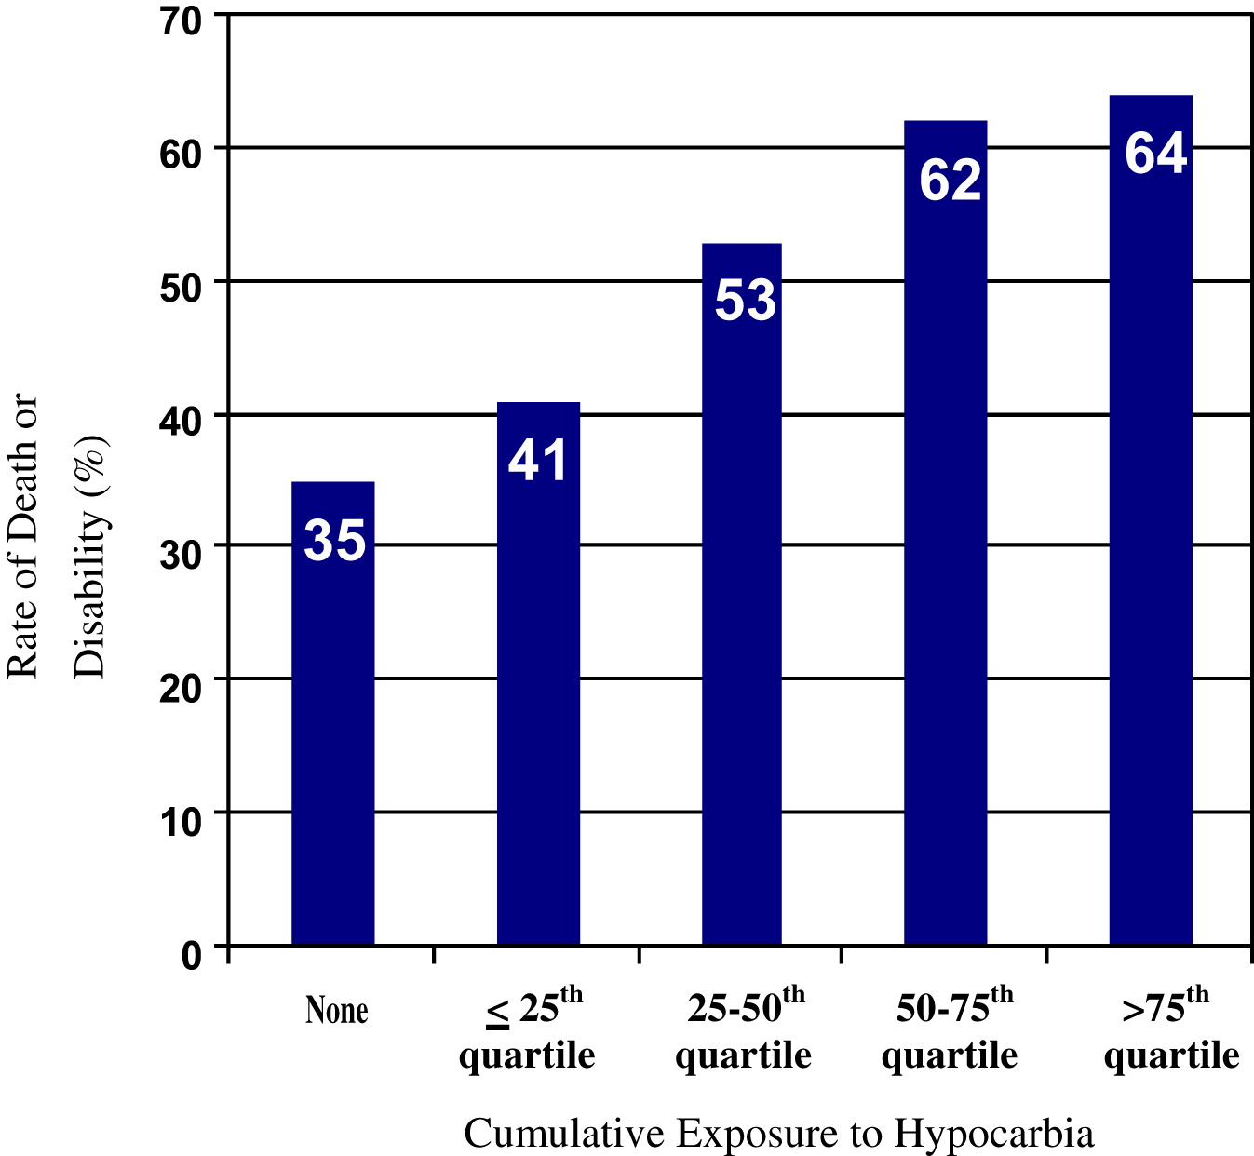

Hypocapnia (PaCO₂ < 35 mmHg): Adverse Outcome in HIE
↓ Cumulative exposure to PaCO₂ of < 35 mmHg
AVOID LOW PCO₂ ESPECIALLY < 35 MMHG (corrected for temp)
↑ Cumulative exposure to PaCO₂ of < 35 mmHg
J Pediatr. 2011 May;158(5):752-758.e1. doi: 10.1016/j.jpeds.2010.10.019. Epub 2010 Dec 10.
Hypocarbia and adverse outcome in neonatal hypoxic-ischemic encephalopathy.
Pappas A, Shankaran S, Laptook AR, Langer JC, Bara R, Ehrenkranz RA, Goldberg RN, Das A, Higgins RD, Tyson JE, Walsh MC; Eunice Kennedy Shriver National Institute of Child Health and Human Development Neonatal Research Network.

Slide 21
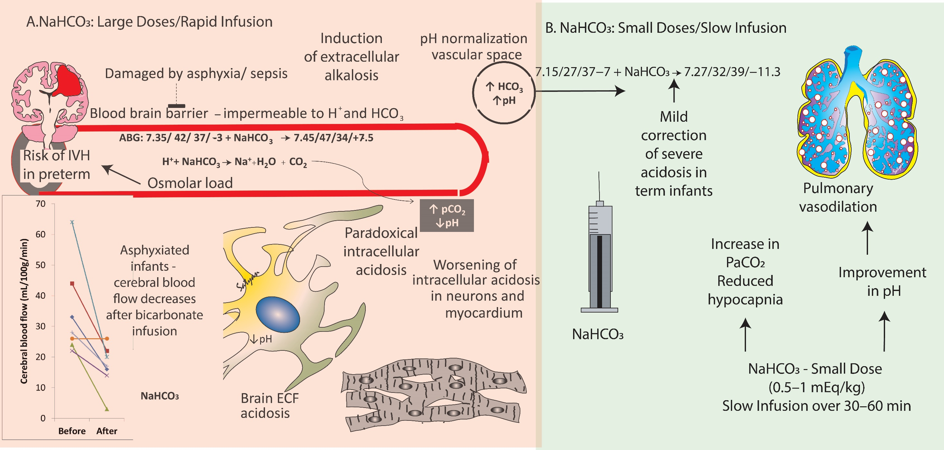
7.17/20/124/7/-19
Baby is tachypneic – on low ventilator settings
0.3*Wt*BE=dose
Is Bicarbonate a Baseless Therapy?
Sankaran, D.; Li, J.R.A. et al. Meconium Aspiration Syndrome, Hypoxic-Ischemic Encephalopathy and Therapeutic Hypothermia—A Recipe for Severe Pulmonary Hypertension? Children 2024, 11,

Slide 22

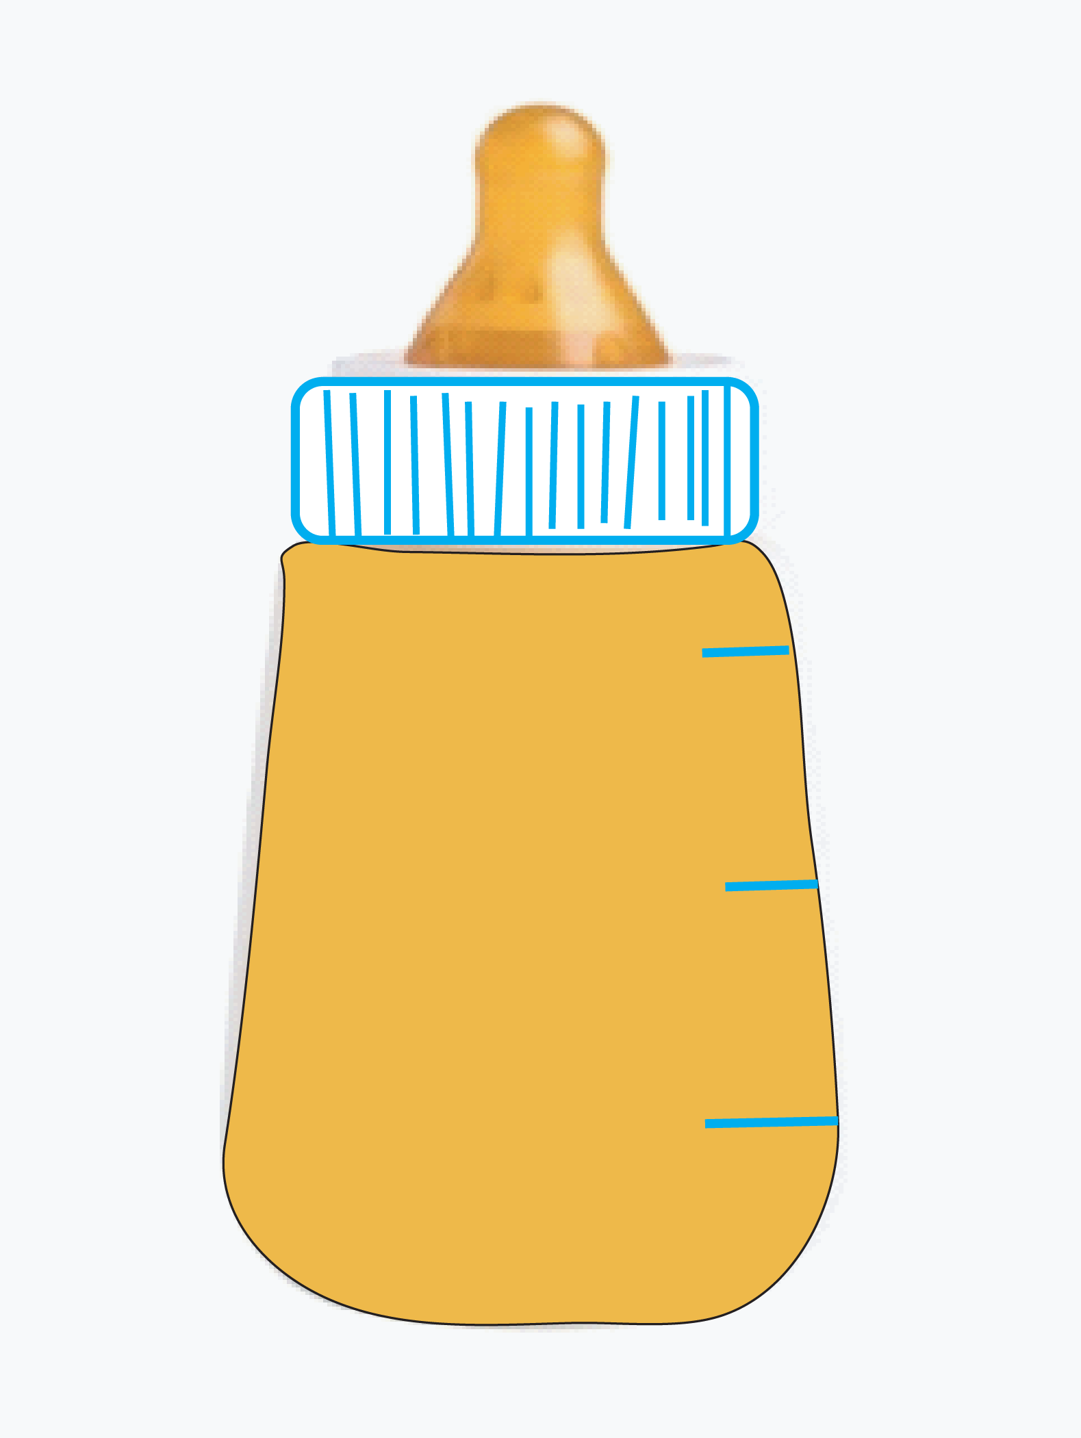
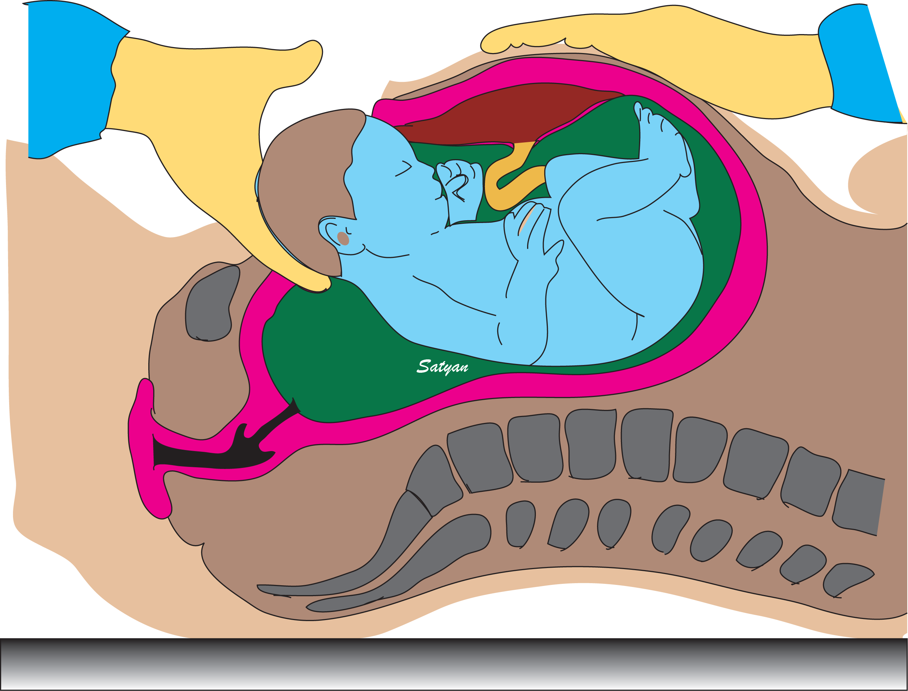
Board Exams: Almost Never the Correct Choice
NaHCO₃

Slide 23
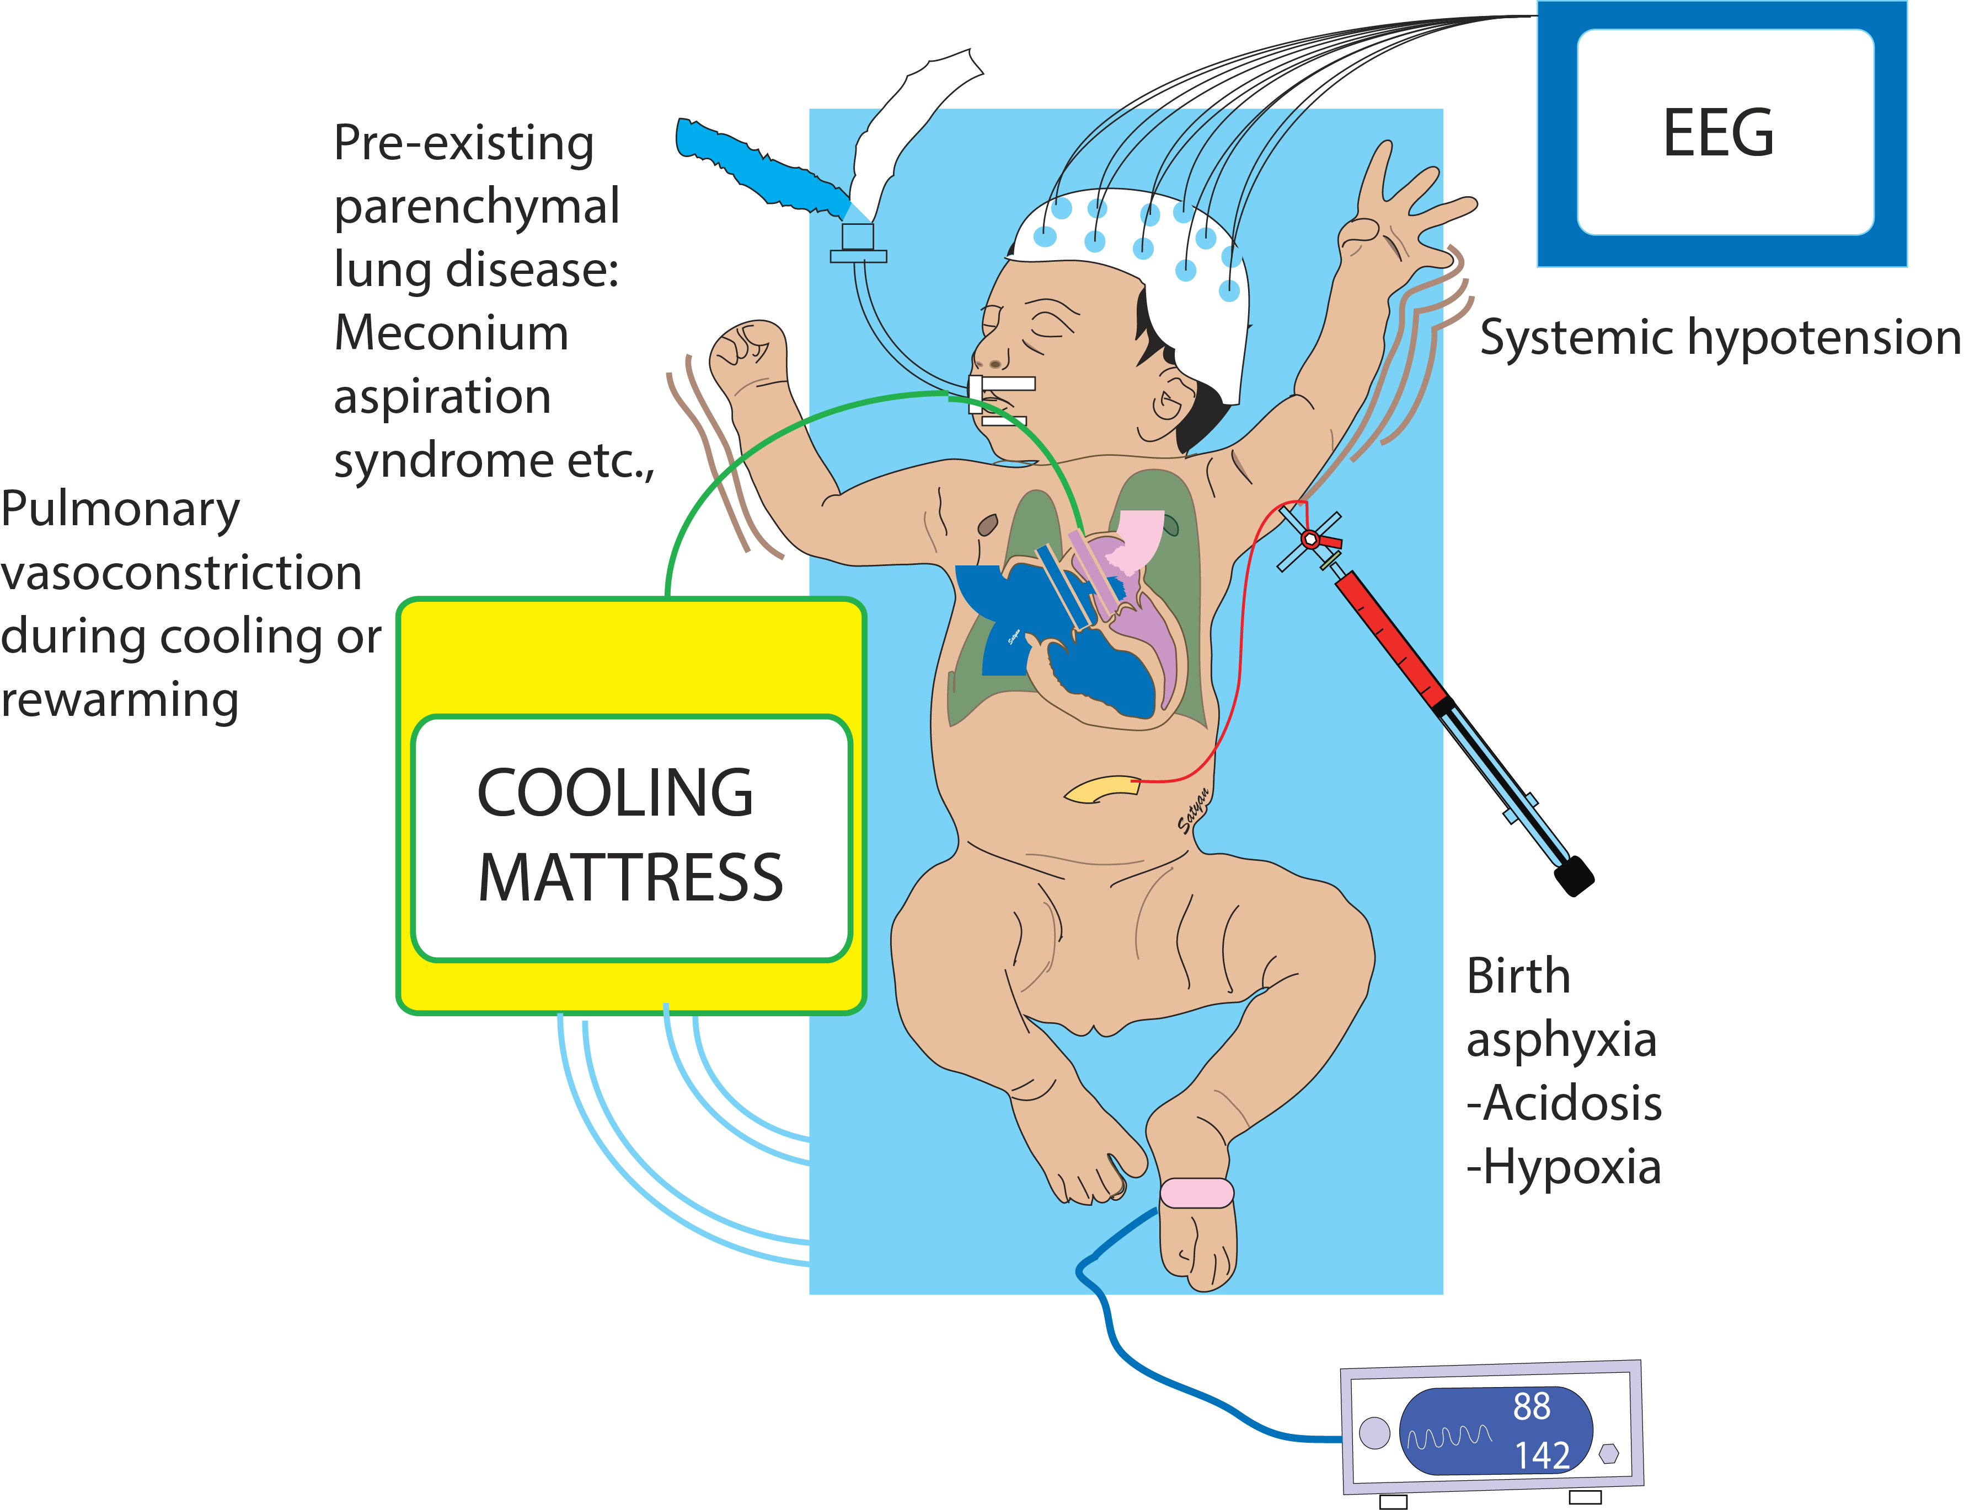
Whole Body Cooling for Moderate HIE
Cooling – especially deep (below 33° C) can exacerbate pulmonary hypertension and worsen oxygenation

Slide 24


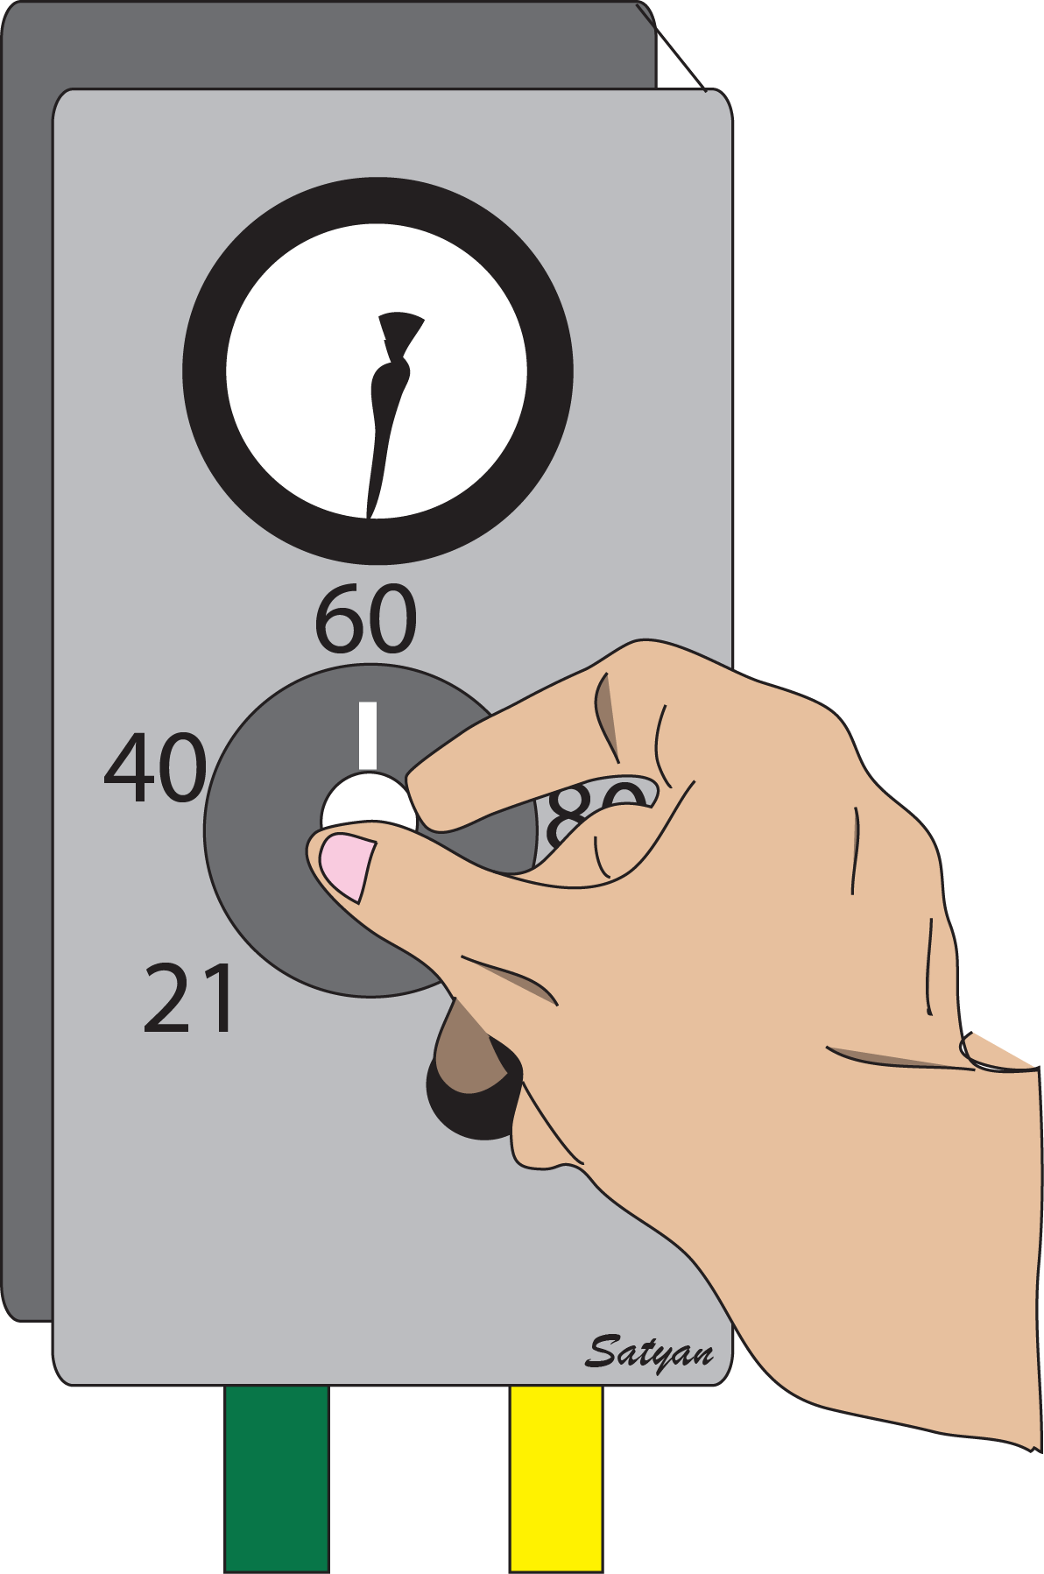
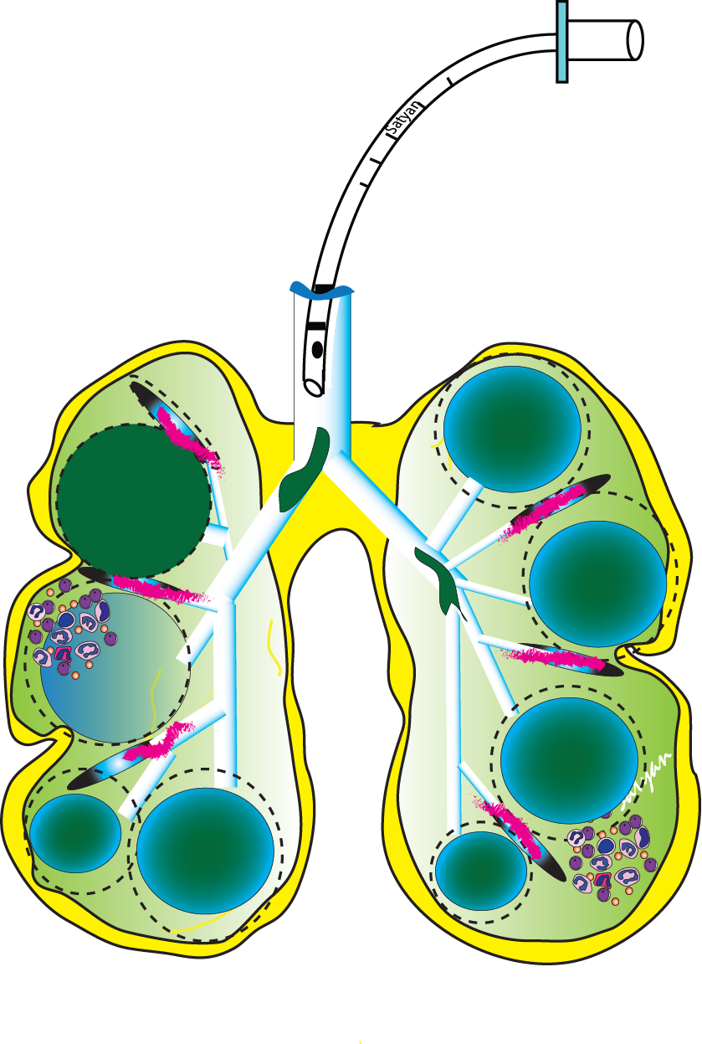
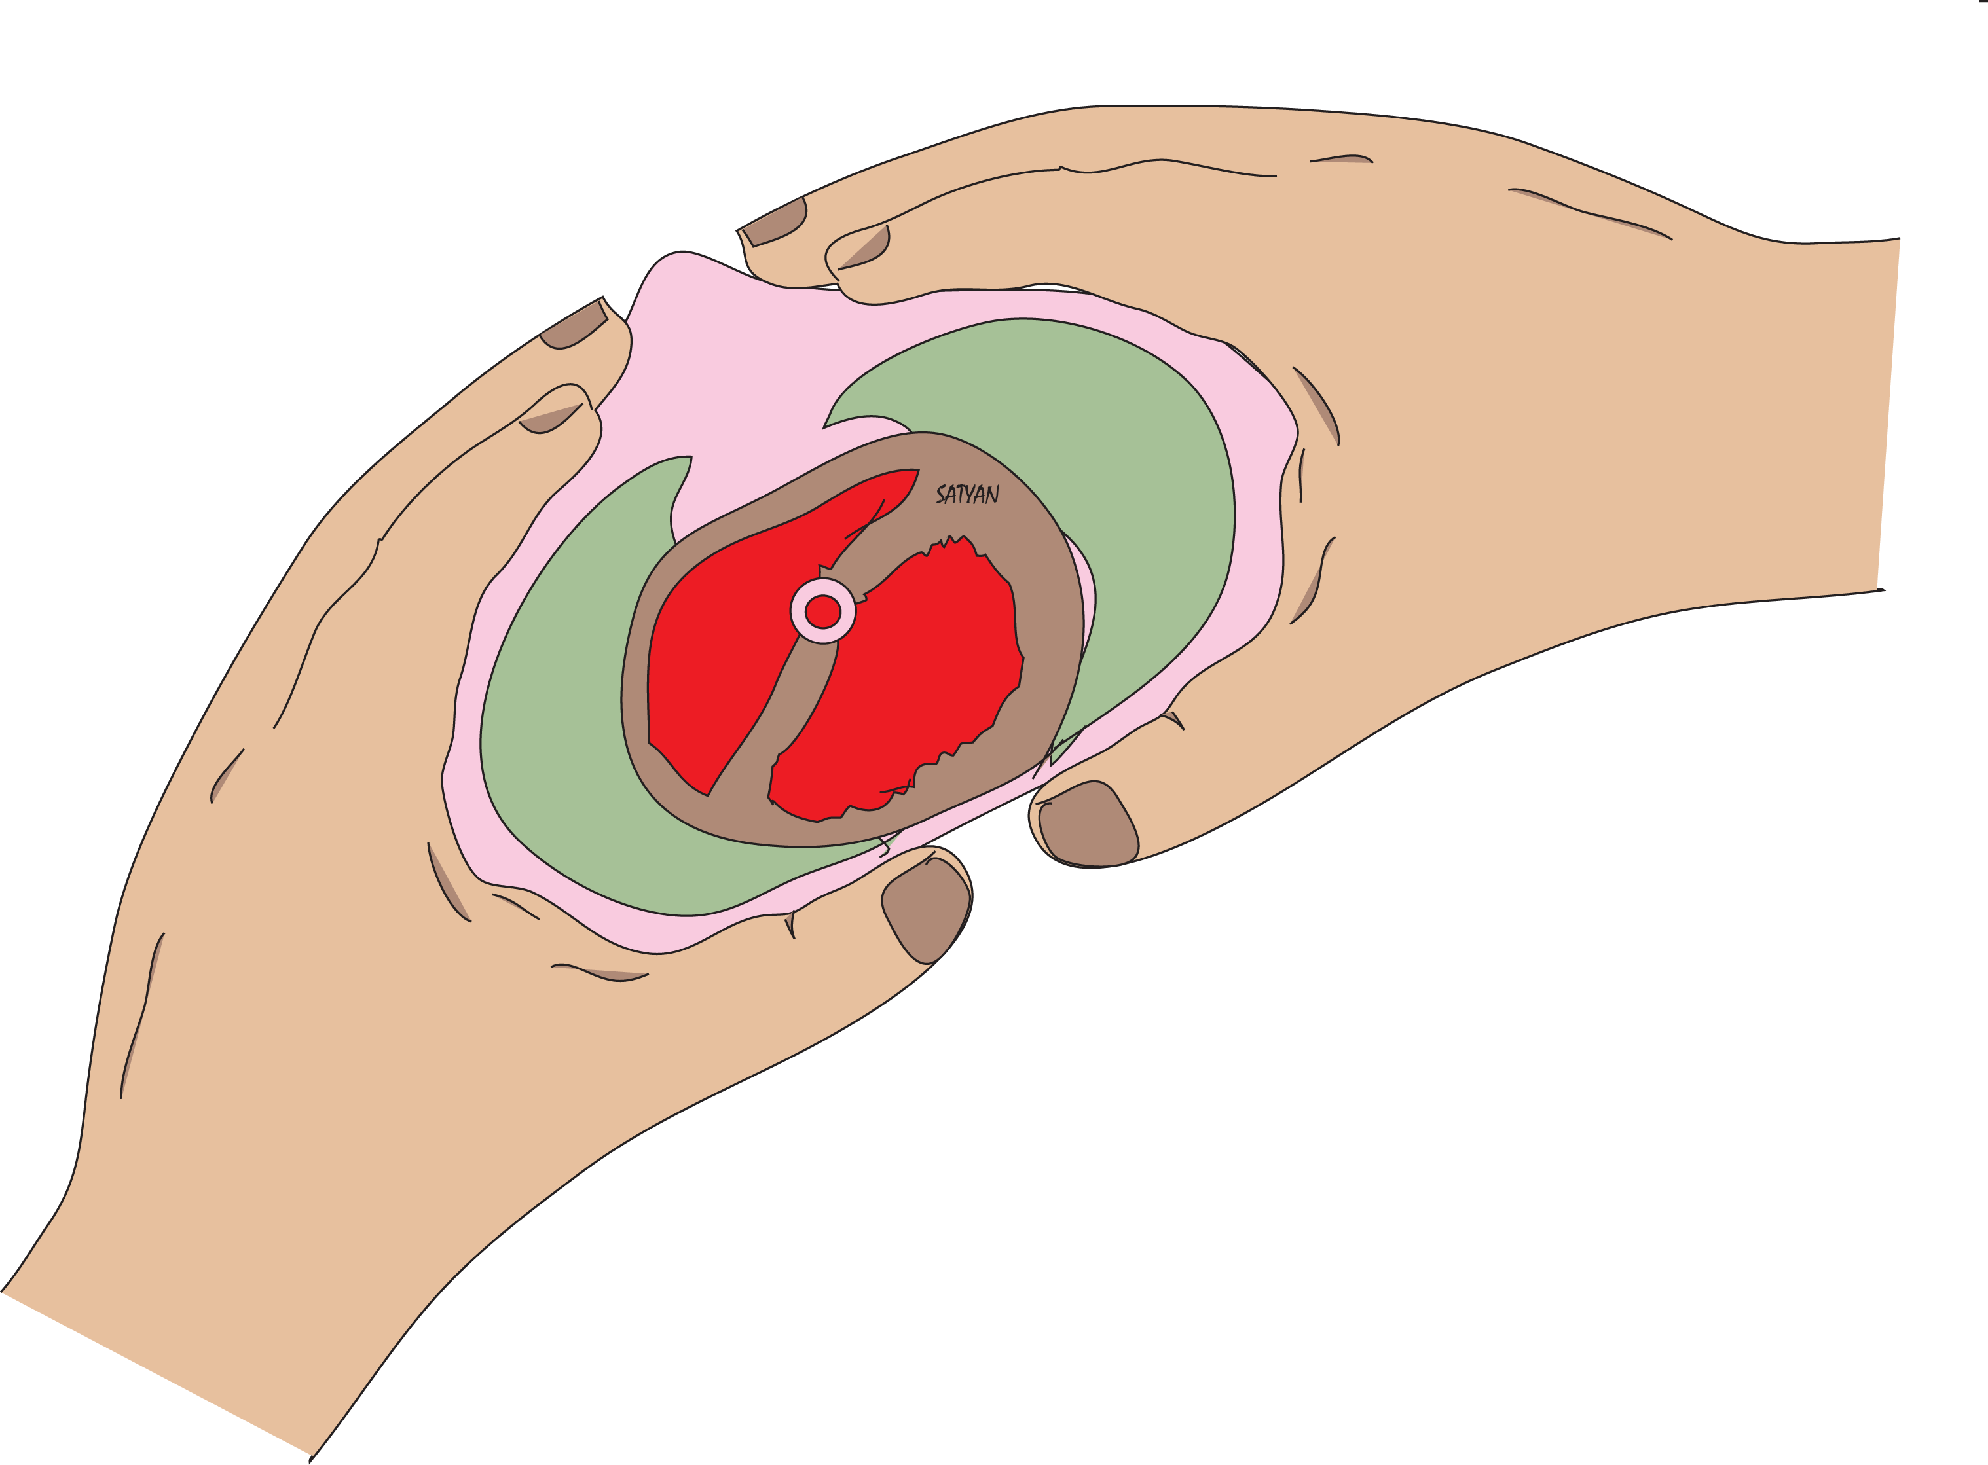
What are the Factors that Predict PPHN Following Asphyxia?
Predisposing parenchymal lung disease – MAS and pneumonia
Need for > 50% O₂ in the immediate postnatal period
Severe
Asphyxia
Need for chest compressions and epinephrine
Lapointe and Barrington J Peds; Lakshminrusimha et al J Peds 2017

Slide 25
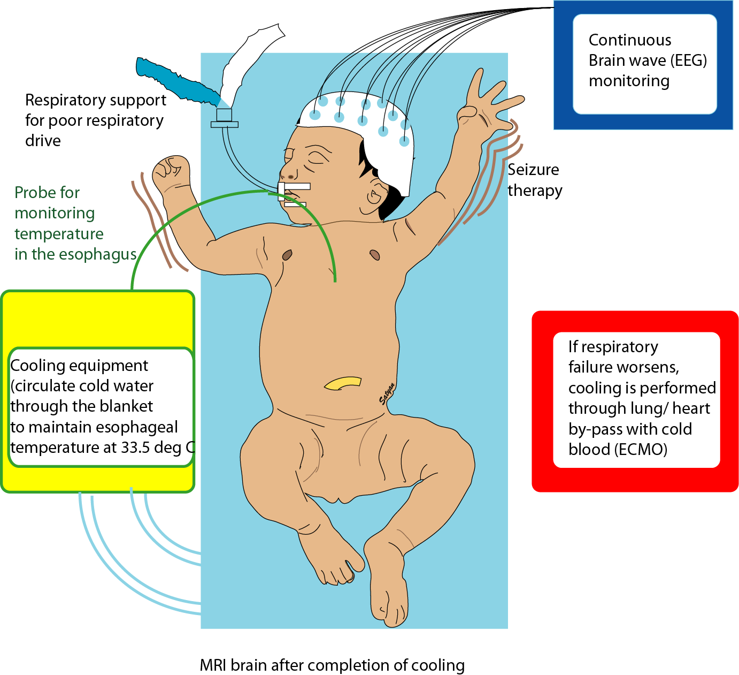
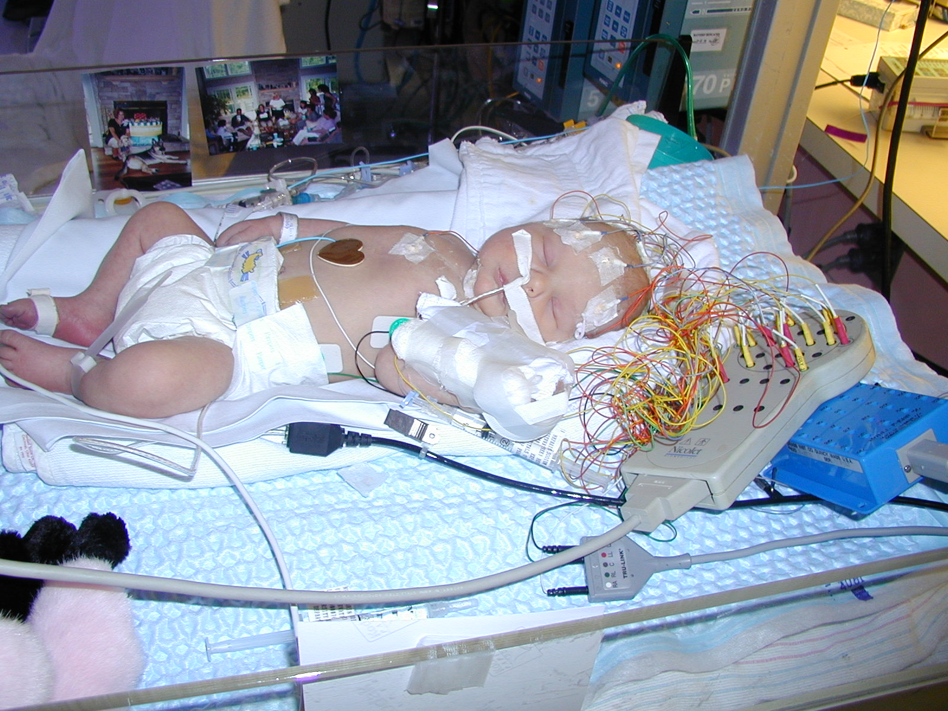
Asphyxia, Hypothermia and Risk of
Systemic Hypotension & PPHN in Clinical Trials
Adverse events | 37°C | 33.5°C |  | 32°C
Systemic hypotension | 35% | 42% | 30% | 35%
PPHN | 22% | 25% | 25% | 34%
Inotropic support | 35% | 42% | 46% | 53%
Inhaled NO | 16% | 17% | 24% | 34% *
ECMO | 2% | 1% | 4% | 9% *
One out of four infants with HIE undergoing hypothermia (33.5°C) has PPHN!
One out of three infants with HIE undergoing hypothermia (32°C) has PPHN!
Shankaran et al Whole- Body Hypothermia for Neonates with Hypoxic-Ischemic Encephalopathy N Engl J Med 2005; 353:1574-1584
* p< 0.05;
Effect of Depth and Duration of Cooling on Deaths in NICU Among Neonates With Hypoxic-Ischemic Encephalopathy JAMA.2014;312(24):2629-2639
Notes:
It has been observed in recent clinical cooling trials that hypothermia further increases the incidence of these adverse events in this predisposed population as shown in the table which has combined data from shankaran et al’s two multicenter whole body hypothermia studies. Incidence of hypotension, PPHN and use of inotropic agents, inhaled NO and ECMO increased with decreasing temperature.
Increased use of inhaled Nitric Oxide and ECMO at lower temperature was statistically significant.

Slide 26
Geisinger et al, Asphyxia, hypothermia PPHN Clinics in Perinatol 2024

Slide 27
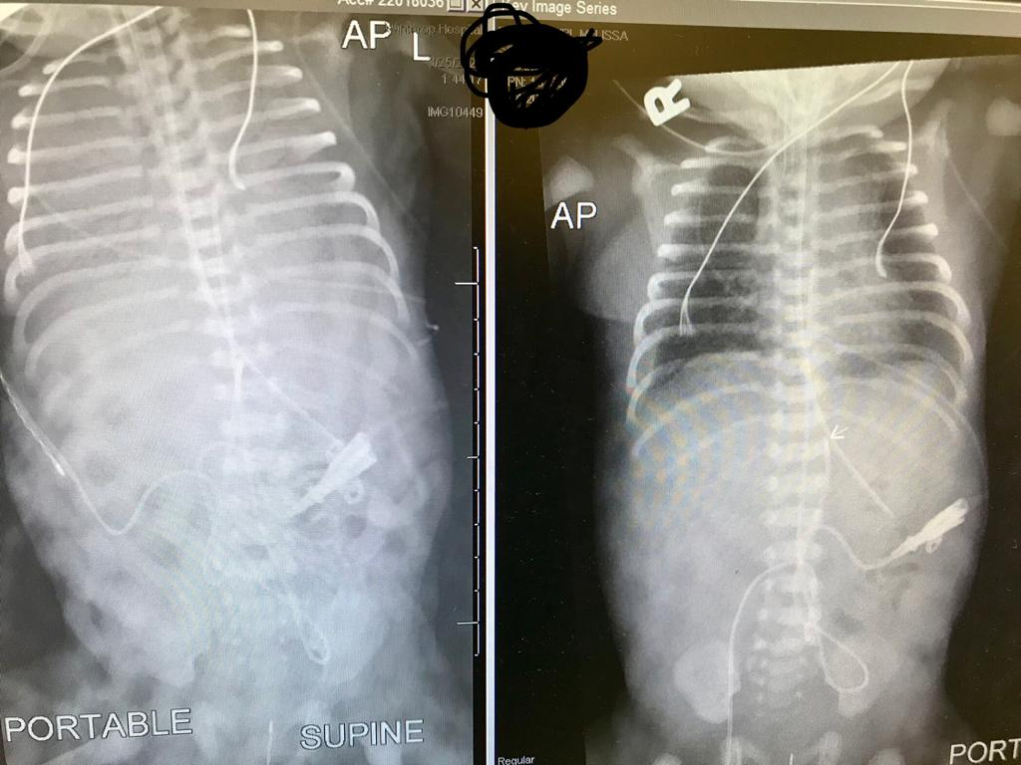
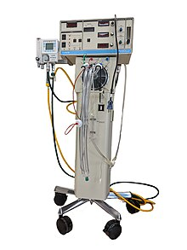
Respiratory Status
C
With the onset of whole-body hypothermia, infant’s oxygen requirement increased to 70% and requiring conventional ventilation.
Further deterioration and now requiring 90% oxygen to maintain preductal SpO₂ > 90%
Started on iNO with minimal improvement: SpO₂ increased from 90% to 93%

Slide 28
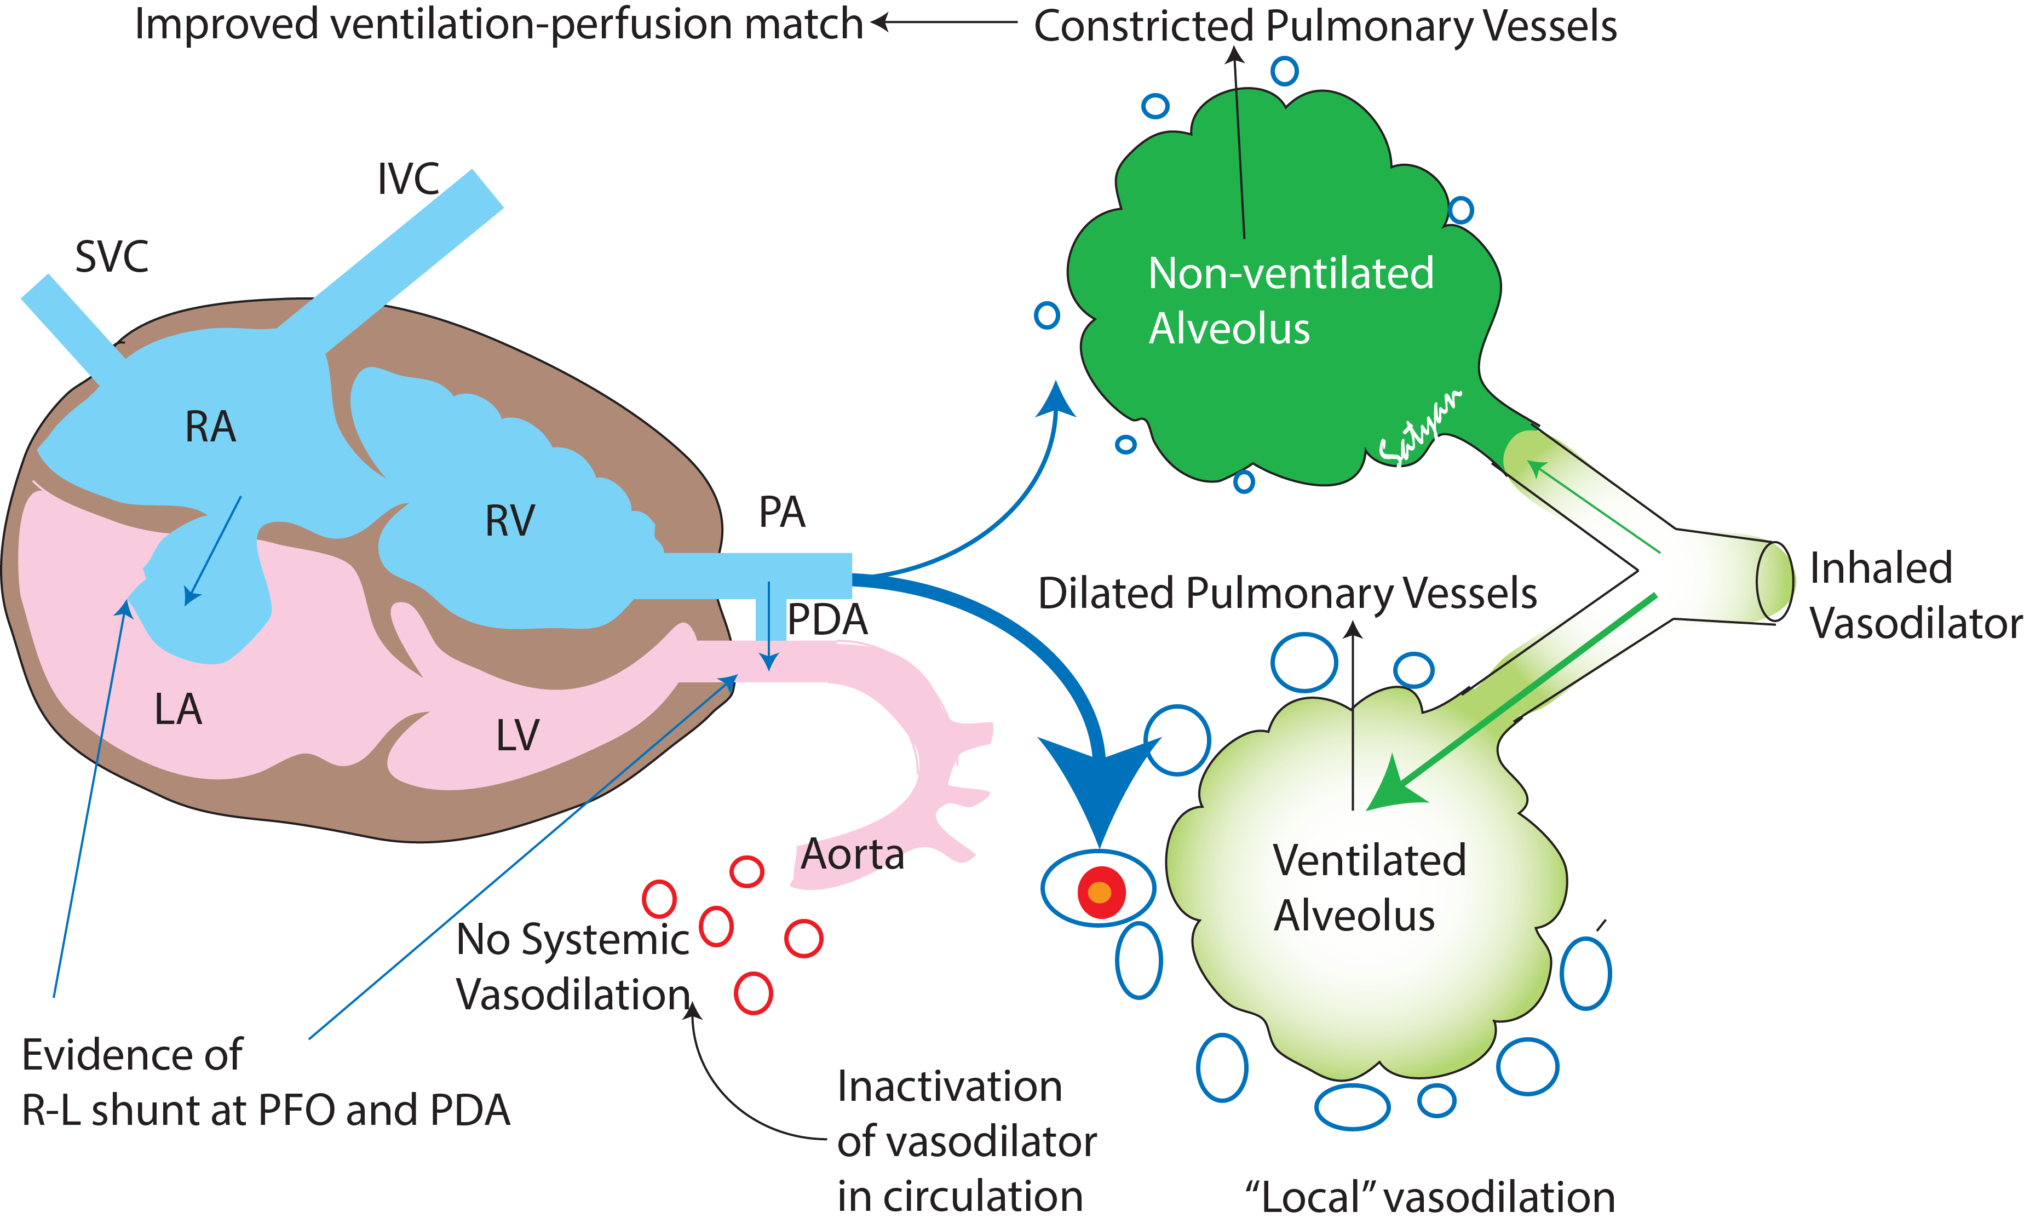
Inhaled Nitric Oxide
Transient improvement in oxygenation after starting iNO does not confirm PPHN
Cookson MW, Kinsella JP. Inhaled Nitric Oxide in Neonatal Pulmonary Hypertension. Clin Perinatol. 2024 Mar;51(1):95-111
SELECTIVE
MICRO-SELECTIVE

Slide 29
Initial settings
C
On HFOV ventilator – 90% oxygen Mean airway pressure – 12 cm water
6.96/63/35/14/-16 (UA) – Oxygenation Index = 12*90 ÷ 35 = 31
Preductal SpO₂ – 93%
Postductal SpO₂ – 75%
What is the next step?
  Increase PEEP/MAP
  Increase FiO₂ to get UA PaO₂ > 100 mmHg
  Transfer to an ECMO center
  Check lactate and urine output
OSI = Paw * FiO₂ * 100 ÷ Preductal SpO₂
Preductal OSI = 12*90 ÷ 93 = 11.6
Simple formula: OSI*2 = OI = 23
NOTE – USEFUL ONLY IF SpO₂ IS 90-96% RANGE
Muniraman et al JAMA Network Open
Rawat et al Neonatology

Slide 30
EMR Documentation: Preductal vs. Postductal
This infant is critically ill with hypoxemic respiratory failure. His postductal oxygenation index is 31.
However, his preductal oxygen saturation is 93% and is within the range recommended by guidelines. His oxygen saturation index is 11.6 and his lactate is 1.3 mM/L.
The ECMO consult team (or center) has been alerted.
There is no indication for ECMO at this time.
Will continue to monitor closely. Lactate is 1.1 mM/L and urine output is 3 ml/kg/h
Discussed the possibility of ECMO along with benefits and risks with the parents.

Slide 31
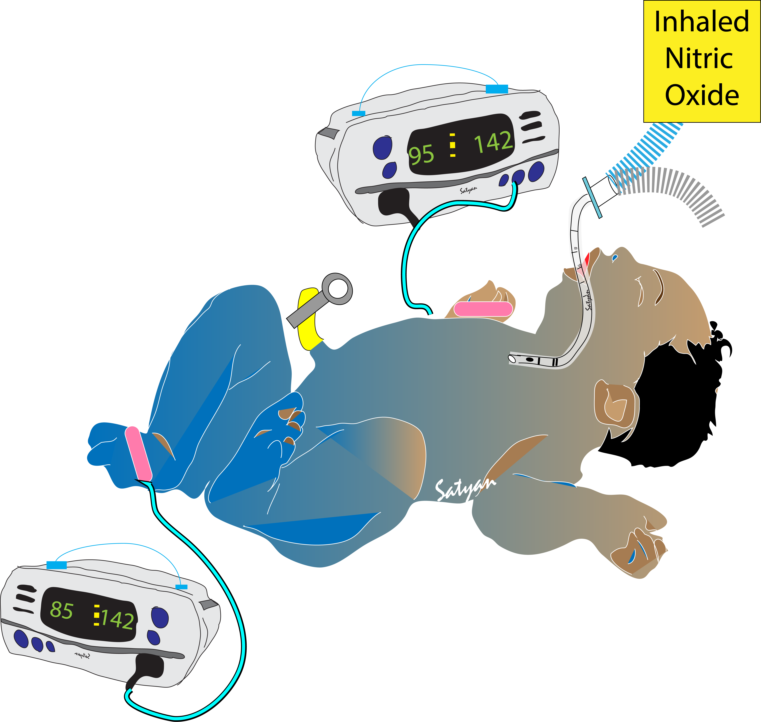
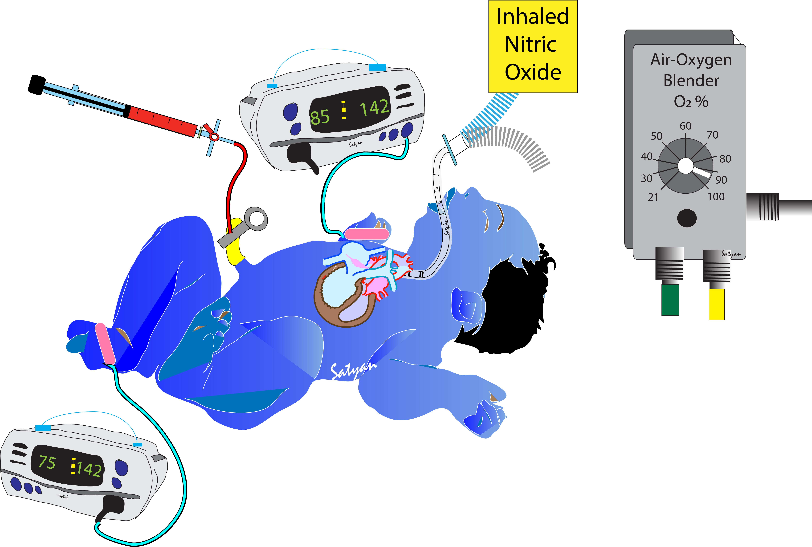

Inhaled NO Responders
Increase in PaO₂ or SpO₂ – preductal vs. postductal
Decrease in FiO₂ or ↑SpO₂/FiO₂ and PaO₂/FiO₂
Sustained improvement in oxygenation
Hemodynamic improvement
Avoiding ECMO

Slide 32
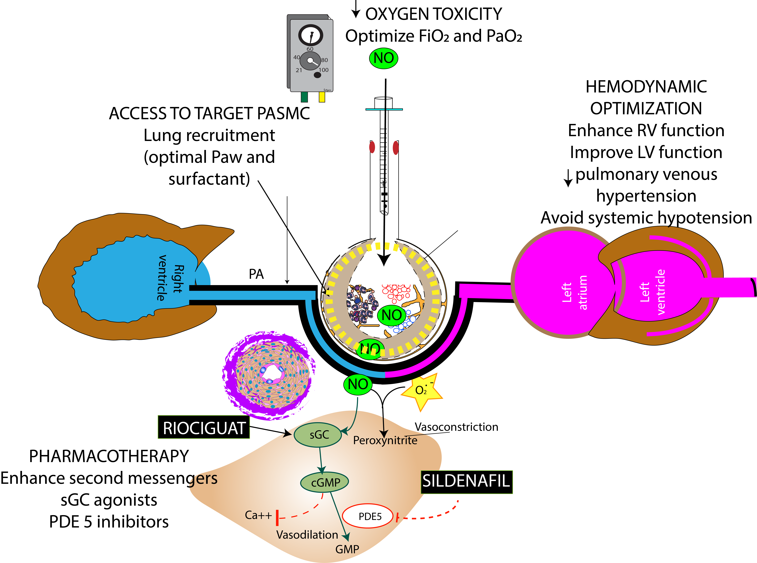
Pathophysiology of iNO resistance:
Optimizing Effect of iNO
Remodeled pulmonary vasculature (“fixed” resistance
Systemic blood pressure
Conditions that do not respond to iNO:
CDH, prematurity and ACD-MPV etc.,

Slide 33
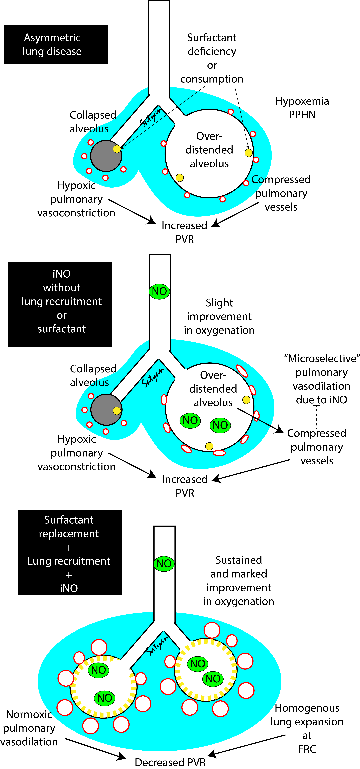
Surfactant + iNO Synergy in Parenchymal Lung Disease
X-ray courtesy Dr. Vikram Dumpa
iNO
Hb (MHb)
target
Gonzalez et al J Perinatol 2020

Slide 34
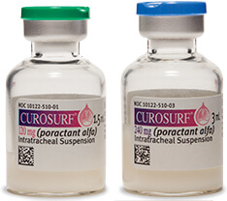
#5 Surfactant + iNO Synergy in Parenchymal Lung Disease
MAS: Consider more frequent administration of surfactant with prior tracheal suctioning (lavage + surfactant inactivation)
Gonzalez et al J Perinatol 2020

Slide 35
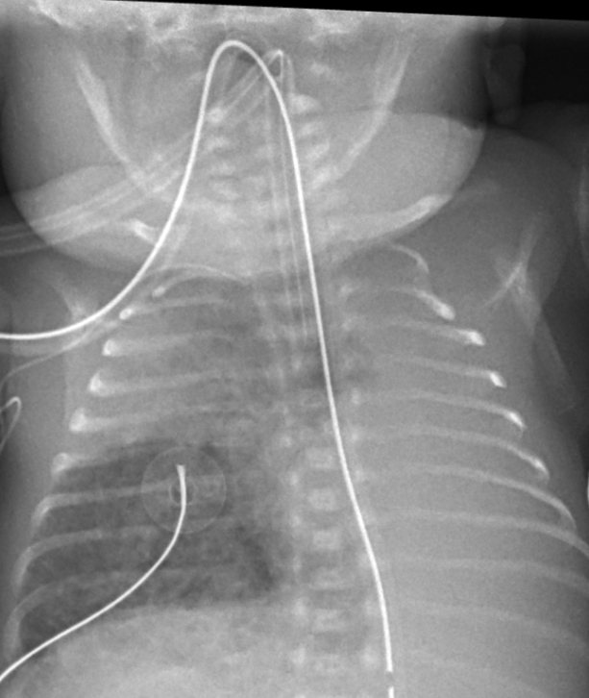
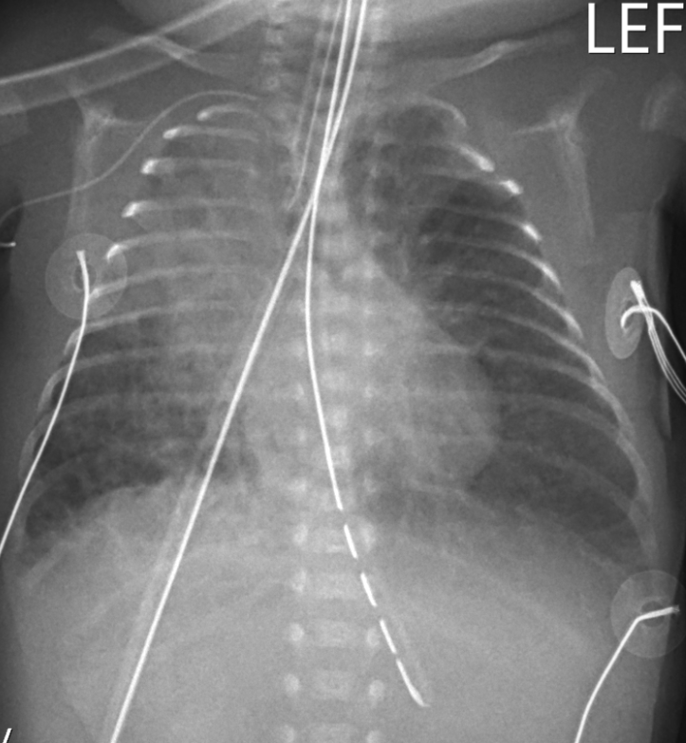
Recruitment and Oxygenation
81% oxygen + 20 ppm iNO
MAP: 23
Hz: 7
Amp: 40
SpO₂: 93%
7.27/69/37/5
Mucus plug
41% oxygen + 20 ppm iNO (weaned off over the next 8 hours;
MAP: 21, Hz: 10, Amp: 42, SpO₂: 91%
7.4/46/51/4
Images Courtesy: Dr. Tri Nguyen, Kaiser Roseville, CA

Slide 36

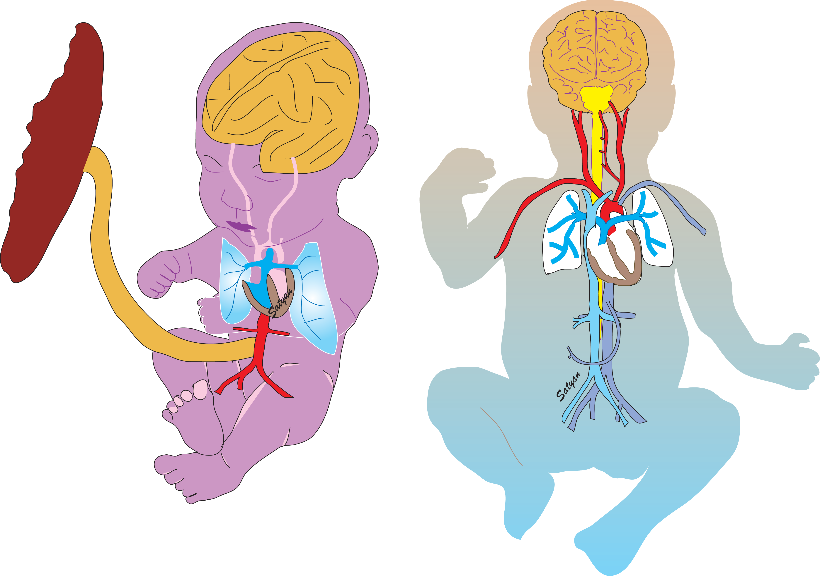
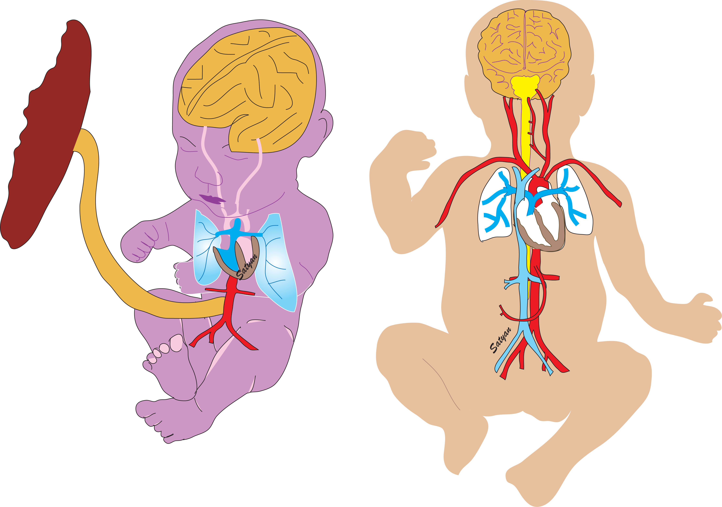
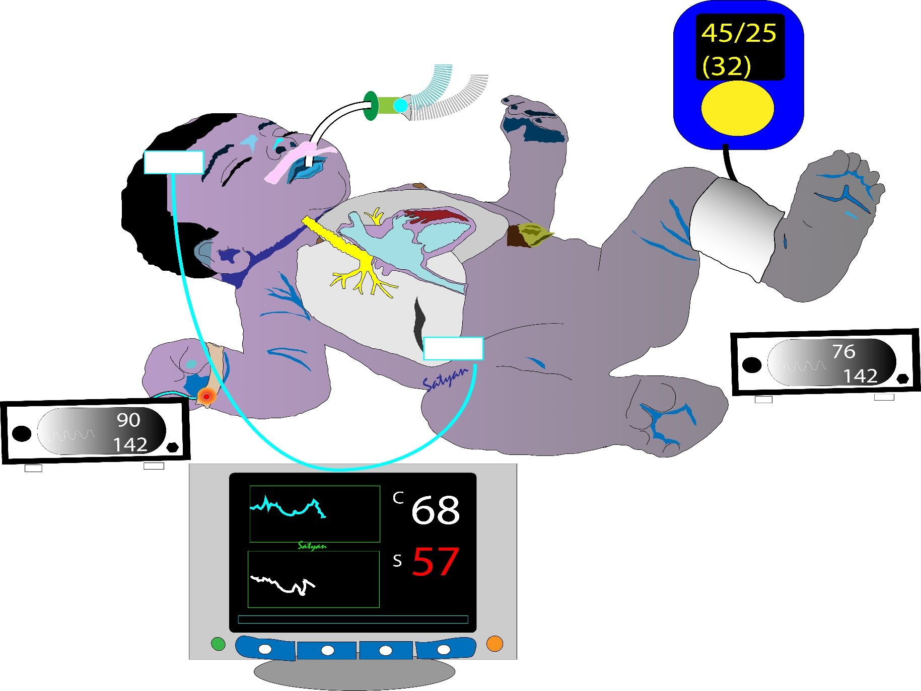

Gentle Ventilation 101: Target Preductal Oxygen
90-97%
Lactate – normal
Urine output - adequate
>80-85%

Slide 37
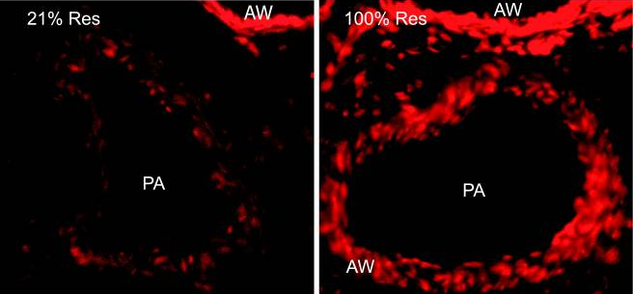
Monitor
by Pulse Oximetry (Pre-ductal)
Lakshminrusimha, Konduri and Steinhorn J Perinatology 2016
21%O₂ 100% O₂
_{Superoxide anions}

Slide 38
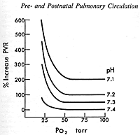
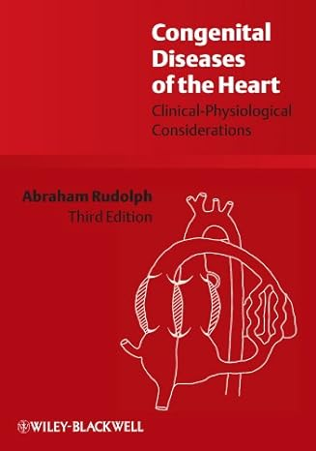
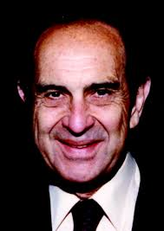
Acidosis Exacerbates Hypoxic Pulmonary Vasoconstriction
Consider targeting
SpO₂ – preductal mid-to high 90s (92-98%)
Acidosis, hypothermia, FiO₂ < 0.6
Change
Point
55 mmHg
Change Point 40 mmHg
Change Point 48 mmHg
Change Point 30 mmHg
Rudolph – congenital heart disease

Slide 39
Occult Hypoxemia in Black Children →
An Explanation for Higher PPHN in Black Infants?
SpO₂ > 90% but ABG SaO₂ < 88%
Andrist E, Nuppnau M, Barbaro RP, Valley TS, Sjoding MW. Association of Race With Pulse Oximetry Accuracy in Hospitalized Children. JAMA Netw Open. 2022;5(3):e224584. PMID: 35357460.

Slide 40
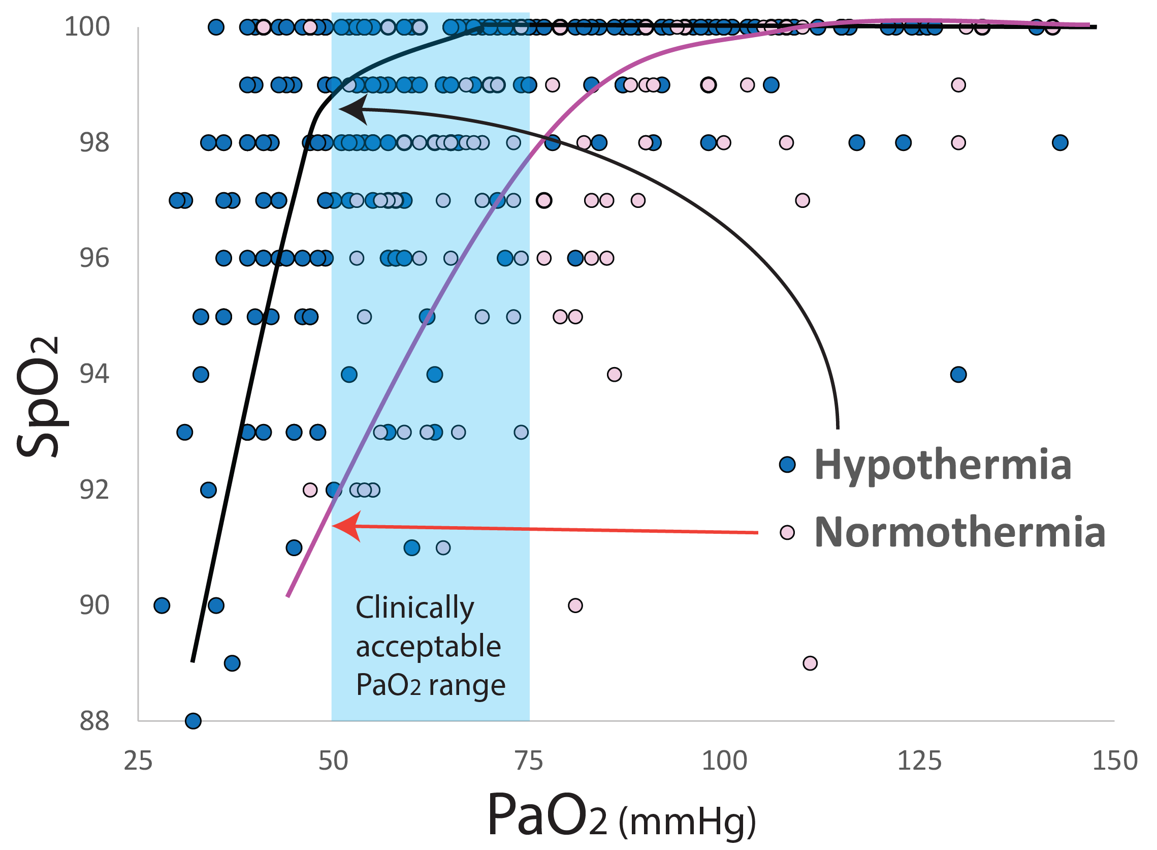

Effect of Hypothermia on O₂ Dissociation Curve
Cooling and PH
Preductal SpO₂
high 90s
PaO₂ 50-80 mm Hg
Hypothermia shifts oxygen-Hb dissociation curve to the left
Afzal et al PCCM

Slide 41

Precision Medicine: SpO₂ vs. PaO₂ vs. FiO₂
Increase FiO₂ – 0.45
SpO₂ – preductal 93%
Postductal 80%
Infant with PPHN
SpO₂ – preductal 91%
Postductal 70%
FiO₂ – 0.3
Severe PH on echo
The risk of hypoxic pulmonary vasoconstriction outweighs risk of oxygen toxicity
Infant with CDH-PPHN
SpO₂ – preductal 90%
Lactate is normal, no acidosis, FiO₂ - 0.8
The risk of oxygen toxicity outweighs risk of hypoxic pulmonary vasoconstriction
Closely monitor pH, lactate and urine output

Slide 42

Oxygen Saturation Targets
Lakshminrusimha S, Abman SH. Oxygen Targets in Neonatal Pulmonary Hypertension: Individualized, "Precision-Medicine" Approach. Clin Perinatol. 2024 Mar;51(1):77-94

Slide 43
Pathophysiology of iNO resistance:
Optimizing Effect of iNO
Remodeled pulmonary vasculature (“fixed” resistance
Conditions that do not respond to iNO:
CDH, prematurity and ACD-MPV etc.,

Slide 44

Rule of 3: Echo changes in PPHN
TAPSE – Tricuspid annular plane systolic excursion
Cera, Sankaran et al
PPHN – Jaypee 2025

Slide 45




Severe LV dysfunction +PPHN
EF 38% by Simpsons biplane
Bidirectional PDA
EF – Ejection fraction
Courtesy: Dr. Amy Stanford, Asst Prof of Pediatrics, U Iowa
Severe LV dysfunction

Slide 46


LV Dysfunction
HSV with LV dysfunction, pleural effusion and pulmonary edema with iNO
Cookson MW, Kinsella JP. Inhaled Nitric Oxide in Neonatal Pulmonary Hypertension. Clin Perinatol. 2024 Mar;51(1):95-111

Slide 47

Milrinone
(Lakshminrusimha and Keszler – Diagnosis and Management of PPHN in Assisted Ventilation of the Neonate 5th ed ~ 2022

Slide 48

Milrinone in HIE/Hypothermia
Creatinine
0.69 ± 0.19 mg/dL
PPHN (not HIE/TH) +milrinone
PPHN (HIE/TH) + milrinone
Creatinine
1.18 ± 0.52 mg/dL
Bischoff et al J Perinatol 2021
Lakshminrusimha and Keszler – Diagnosis and Management of PPHN in Assisted Ventilation of the Neonate 5th ed ~ 2022;

Slide 49
How to enhance the effect of iNO in PPHN?
HYDROCORTISONE

Slide 50
Sildenafil
(Lakshminrusimha and Keszler – Diagnosis and Management of PPHN in Assisted Ventilation of the Neonate 5th ed ~ 2022
Steinhorn et al J Peds 2009
Pierce et al J Peds 2021
Hypo-tension – 27.6%
(Sepsis)

Slide 51


Slide 52

RV Afterload

Slide 53




Echo severe RV dysfunction with a closing ductus
FAC of 0.19
Courtesy: Dr. Amy Stanford, Asst Prof of Pediatrics, U Iowa
TAPSE of 3

Slide 54

How to keep the Heart Happy?
Courtesy Regan Giesinger, MD
“Selective” systemic vasoconstrictor: Vasopressin or Norepinephrine
M
V
P
Lakshminrusimha and Keszler – Diagnosis and management of PPHN – Assisted Ventilation of the Neonate (submitted)

Slide 55



PGE1 in PPHN?
When to stop IV PGE1 in PPHN?
Indication for PGE1
Reopened PDA by PGE1 to ↓ RV afterload
Restrictive PDA with high RV afterload
Start PGE1 to reduce RV afterload with supra-systemic PH
Wean or stop PGE1 when:
  Respiratory status is improving
  There is no preductal-postductal SpO₂ gradient
  Other therapies are deescalating
  Echocardiogram shows that PVR/PA pressures are sub-systemic
NOTE: It is important not to continue PGE1 after reversal of R→L shunt to L→R as it can worsen LV preload
Shunt becomes L→R and there is no more preductal to postductal SpO₂ gradient
Continuing IV PGE1 with a large L→R shunt can cause pulmonary flooding
↑ systemic perfusion “Blue blood is better than no blood”
Ductal steal L→R can lead to postductal systemic hypoperfusion
Systemic hypoperfusion due to LV dysfunction and ↓ LV preload

Slide 56


Blood Pressure Management

Slide 57
Systemic Hypotension
C
After starting IV milrinone in addition to iNO, umbilical arterial blood pressure tracing is 47/25 (mean – 34) mmHg
Preductal SpO2: 93%, Postductal: 85%, Lactate: 1.2 mM/L, Urine output – 0.7 ml/kg
What is the next step?
Permissive hypotension: continue to monitor lactate and urine output
Check Central venous pressure through UV line
Administer a fluid bolus: 10 ml/kg (normal saline vs. LR)
Start vasopressor (dopamine vs. epinephrine vs. norepinephrine vs. vasopressin)

Slide 58


Neonates Do Not Read Physiology Textbooks

Slide 59

Central Venous Pressure (CVP)
Transducing a centrally placed UVC can measure CVP

Slide 60
Co-existing PPHN can Increase RA Pressure
(CVP unreliable)
↓ Central Venous
Pressure
↑ Right atrial
Pressure
↑Cyanosis
↓ Blood Pressure
↓ Blood Pressure
Reduce Blood Flow
Persistent Pulmonary Hypertension of the Newborn

Slide 61


Management – Fluid Bolus during PPHN
Indications – low preload
Contraindications – cardiac failure (pulmonary edema), high CVP
Fluid
  Crystalloid – Normal Saline vs. Lactated Ringer
  Colloid – Albumin (NOT PREFERRED)
  Blood products – PRBC, FFP
Effect
  Reduced pH with normal saline (hyperchloremic acidosis)
  Increased lactate (1 mM/L for 30ml/kg) with LR
  LR – not compatible with TPN
Right
Atrium
pH
5.0
6.5
So KW et al Arch Dis Child Fetal Neo Ed 1997
Barr PA et al Pediatrics 1977
Oca M et al J Perinatol 2003

Slide 62


Lactate, Acetate vs. Bicarbonate
High Anion Gap Metabolic Acidosis
Lactic acid > 4 mM/L with other signs of hypoperfusion such as delayed cap refill are suggestive of tissue hypoxia and/or ischemia and predicts low SVC flow.
Sodium or potassium acetate
BASE trial – Dr. Sabitha Uthaya, UK
NaHCO3 vs. placebo in preterm infants with metabolic acidosis
Sodium bicarbonate
Rabinowitz, J.D., Enerbäck, S. Lactate: the ugly duckling of energy metabolism. Nat Metab 2, 566–571 (2020).

Slide 63

Dopamine is not Selectivite to Systemic Circulation
Control Systemic BP
PPHN Systemic BP
PPHN Pulmonary Arterial Pressure
Control Pulmonary Arterial Pressure
Kirmani et al E PAS 2007; Lakshminrusimha et al Clin Perinatol 2012 McNamara et al J Peds 2022

Slide 64



Why is Increasing Systemic Pressure with Dopamine to Supra-physiological Levels a Bad Idea in PPHN?
Dopamine is non-selective
Do not stress the heart
PFO – pop off # 1
Systolic pulmonary pressure – 100 mmHg
Left Ventricular Dysfunction
Pop-off valve
Ductal-Dependent Systemic Circulation
Right ventricular failure
Dopamine
Constricted pulmonary circulation
pop off # 2

Slide 65


Six ‘P’s Before You Start Treating Hypotension
# 1 P
Perfusion
# 2 P
Pressure (systolic, mean and diastolic)
# 4 P
Pump? (RV or LV output)
# 3 P
Peripheral Vascular Resistance
# 5 P
Pulmonary hypertension
# 6 P
Pee (urine output)
Perfusion ↓
Pressure ↓↓↓
Peripheral vasc resistance ↓
Pump failure – good LV/RV f
Pulmonary hypertension - Yes
Pee (urine output) – low
Choice: Norepinephrine
Perfusion
Pressure
Peripheral vasc resistance
Pump failure
Pulmonary hypertension
Pee (urine output)

Slide 66
Choice of Therapy
Perfusion – if good with normal lactate and urine output, may consider delaying treatment of hypotension (“Permissive hypotension)
Pressure – systolic (pump), diastolic (peripheral resistance)
Peripheral vascular resistance (needs a vasopressor – NE/vasopressin)
Pump failure (needs an inotrope – milrinone or epinephrine)
Pulmonary hypertension (prefer norepinephrine or vasopressin)
Pee (urine output – vasopressin may cause oliguria)

Slide 67
Systemic Hypotension in PPHN
Blood pressure | Normal | Low
Normal cardiac function | Inhaled NO, sildenafil | Norepinephrine or Vasopressin* + iNO
Poor cardiac function | Milrinone + iNO | Epinephrine + iNO (consider hydrocortisone
Risk of hyponatremia and oliguria*

Slide 68
Norepinephrine
Box. Norepinephrine
Indication | Hypotension without decreased cardiac function, hypoxemia
Dose | 0.05 to 0.5 mcg/kg/min – occasionally may need up to 1 mcg/kg/min in PPHN with severe hypotension²²
Monitoring | Pulse oximetry, blood gases, lactic acid, blood pressure
Precautions | Increased systemic vasoconstriction may decrease mesenteric perfusion and tolerance/safety of feeding Watch for extravasation – (extravasation will need therapy with Phentolamine)
Contraindications | Significant cardiac dysfunction unless using with an inotropic agent as well
Class of Recommendation | Class IIa – Weight of evidence/opinion is in favor of usefulness/efficacy. Should be considered
Level of Evidence | C – Consensus of opinion of the experts and/or small studies, retrospective studies, registries

Slide 69
Vasopressin
Box 7. Vasopressin
Indication | Refractory pulmonary hypertension and systemic hypotension, however no literature in earlier use
Dose | 0.1 to 2 milliunits (mU)/kg/min
Monitoring | Pulse oximetry, blood gases, lactic acid, blood pressure, sodium
Precautions | Hyponatremia, systemic vasoconstriction may affect mesenteric perfusion and tolerance/safety of feeding and may be deleterious in the setting of LV dysfunction.
Contraindications | Hyponatremia
Class of Recommendation | Class IIb – Usefulness/efficacy is less well established by evidence/opinion. May be considered
Level of Evidence | C – Consensus of opinion of the experts and/or small studies, retrospective studies, registries

Slide 70

Hydrocortisone ?
Norepinephrine
Placenta – source of CRH
Catecholamine-Resistant Hypotension
Glucocorticoid activity
Relative adrenal insufficiency

Slide 71
Hydorcortisone
Box 8. Hydrocortisone
Indication | Catecholamine-resistant systemic hypotension Refractory pulmonary hypertension not responsive to inhaled nitric oxide
Dose | Acute crisis: 1 mg/kg/dose q 6 h Maintenance: 1 mg/kg/day in divided doses Severe PPHN not due to infection – 4 mg/kg/dose x 1 followed by 1 mg/kg q 6h x 4 doses followed by maintenance
Monitoring | Blood glucose, blood pressure, sodium, watch for infection
Precautions | Occult infection – fungal, viral (herpes simplex, CMV etc.,), bacterial can be exacerbated with steroid therapy
Contraindications | Known or suspected infection
Class of Recommendation | Class IIb – Usefulness/efficacy is less well established by evidence/opinion. May be considered
Level of Evidence | C – Consensus of opinion of the experts and/or small studies, retrospective studies, registries

Slide 72
Hydro-cortisone?
Alsaleem et al Clin Med In 2019
Inotrope Score
BP
PaO₂
IV Hydrocortisone 4 mg/kg load followed by 1mg/kg q 8h x 24h and then maintenance cortisol
OI
Erika Fernandez et al NRN RCT
Stopped early due to poor enrollment

Slide 73

What Would the Fetus Do?
Avoid hyperoxemia
Blue blood is better than no blood (cyanosis with good perfusion is better than ischemia)
Maintain ductal patency if RV is suprasystemic
Avoid high systemic blood pressures

Slide 74


Fetal Secrets
How does the fetus thrive with severe pulmonary hypertension?
High Hemoglobin (maintain decent Hct)
Fetal hemoglobin (Delayed cord clamping?)
Lungs maintained at FRC with lung liquid
  Optimal lung inflation
Normal systemic blood pressure (low LV afterload)
  Avoid excessive systemic hypertension
Ductal patency to reduce RV afterload
  Use of PGE1
Oxygen – focus on delivery to tissues and not PaO₂ or SpO₂

Slide 75
Hypoxemic Respiratory Failure (HRF OI>15)
ABG, CXR and optimize lung recruitment and ventilation (rule out air-leak syndromes and mechanical causes of HRF
Systemic Blood Pressure (BP) and Echocardiography
No evidence of PH (rule out other causes of HRF – parenchymal lung disease, MetHb etc.,)
Evidence of PH - Yes
INHALED NITRIC OXIDE (20 ppm)
HYDROCORTISONE (1mg/kg q12h)*
Primary or severe LV dysfunction
Sustained improvement
(MONITOR)
Poor or ill-sustained response
Avoid iNO unless LV dysfunction is due to ↑↑ RV afterload
Inotropes + LV afterload reduction
RV dysfunction or failure
Low ← Systemic BP → Normal
No
Yes
Normal ← Systemic BP → Low
Normal ← Systemic BP → Low
MILRINONE – preferred; or DOBUTAMINE
HYDROCORTISONE* (↑4mg/kg load; 1mg/kg q8h), NOREPINEPHRINE
VASOPRESSIN
MILRINONE
PGI₂
PGE1 (if ductus restrictive)
HYDROCORTISONE* (↑4mg/kg load; 1mg/kg q8h),
EPINEPHRINE, NOREPI, VASOPRESSIN, ECMO
SILDENAFIL
PGI₂
*hydrocortisone is used only in the absence of infection

Slide 76


Managing Hypoxemic Respiratory Failure + HIE:
Dynamic
Ventricular dysfunction; IV MILRINONE!
High pulmonary vascular resistance; INHALED NITRIC OXIDE STAT!
HIE – Therapeutic hypothermia!
Parenchymal lung disease – OXYGEN AND SURFACTANT!
HRF
HIE
Systemic blood pressure is low; VASOPRESSIN!
The Blind Men and the Elephant. 8.1.1 a. A poem by John Godfrey Saxe (1816–1887). (Based upon a Hindu Parable)

