Slide 1

Pierre Robin Sequence and Mandibular Distraction
Kaiser SCPMG
Stacey Francis, MD
Craniofacial Surgeon

Slide 2

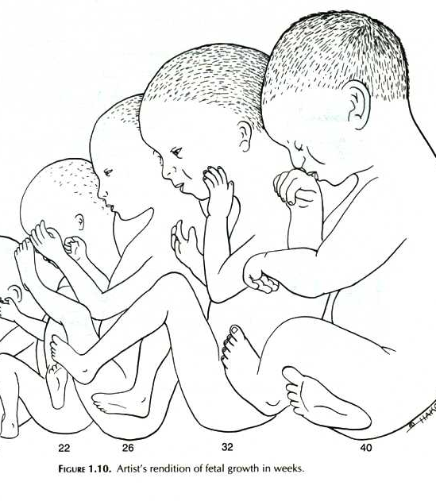
Obstructive Sleep Apnea in the Neonate and Infant
The correlation between micrognathia and neonatal airway obstruction was originally described by Pierre Robin in 1920’s
Glossoptosis
Micrognathia or retrognathia
Respiratory distress
Often cleft palate (wide U shaped)
1/20,000 to 1/30,000 live births

Slide 3
Clinical Red Flags
Desaturations in supine position
ANY desat in prone or lateral position
Work of breathing, retractions
Apnea, hypopnea, tachypnea
Poor feeding
Consideration of feeding tube
Failed car seat test

Slide 4
Pre-op Work-up
Labs: HCO3 (CBG or Chemistry)
Documentation of desaturations- degree, position, length
Sleep Study
3D CT scan
Multidisciplinary team- consults
Neonatologist
Pulmonologist/Sleep Medicine Specialist
ENT
Plastic Surgeon/Craniofacial Surgeon

Slide 5
Polysomnography
Can be done as inpatient at FMC
Specific parameters used: AHI, hypoventilation, hypoxia
NAPTIME study not as effective
Importance to distinguish central vs obstructive sleep apnea

Slide 6
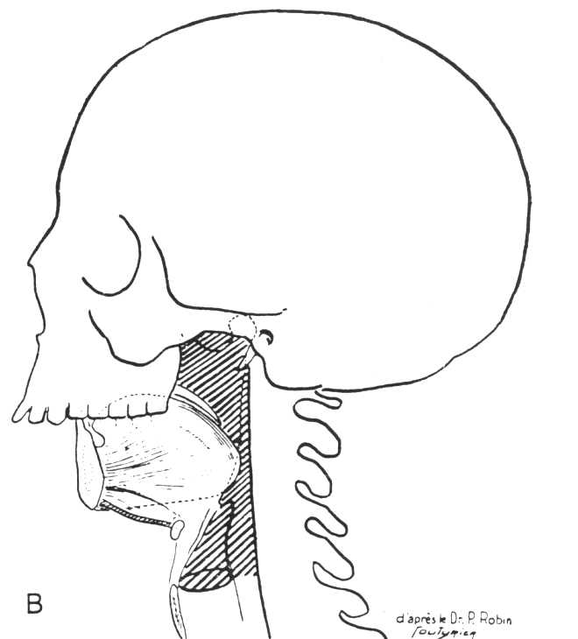
Management Options
Acute Conservative:
Lateral or Prone positioning
Supplemental oxygen
Nasopharyngeal airway
Surgical:
Tongue lip adhesion
Mandibular Distraction
Tracheostomy

Slide 7
Management based on respiratory status
Respiratory distress
Initial conservative measures failed:
prone position and supplemental oxygen
Sleep study performed to evaluate the Apnea Hypopnia Index(A.H.I.), hypoxemia, and hypoventilation
Respiratory failure
Required intubation for oxygenation
No sleep study performed

Slide 8
Contraindications to Distraction
Central sleep apnea
Severe esophageal reflux
Primary lung disease
Airway lesions
Co-morbidities
Poor prognosis

Slide 9
The Risk of No Intervention
Persistent OSA > pulmonary hypertension > cor pulmonale
2011 event- KP infant presented with heart failure

Slide 10
What are the Goals?
For Respiratory Distress:
Wean off supplemental O2
Prevent long term OSA complications
CHF
For Respiratory Failure:
Extubation
Avoid tracheostomy

Slide 11
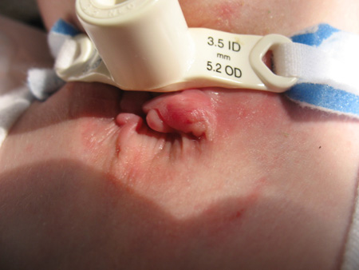
Tracheostomy Morbidity
Published morbidity ranges from 5%-70%
Hemorrhage – early or late :
Erosion of innominate artery
Tracheoinnominate fistula
Pneumothorax
Obstruction with mucous, blood
Displacement
Infection
Tracheal stenosis
Tracheocutaneous fistula
Delayed language development
Significant psycho-social impact on family
Financial impact as a surgical burden of disease

Slide 12
Distraction Osteogenesis (slow growing bone)
Principles of Distraction Osteogenesis
Latency phase (24 hours)
Distraction phase (2-3 weeks)
1.8 mm/day (2 turn/every 8 hours)
extubate during this phase
Consolidation phase (3 months)
3 stages (2 surgeries) ( requiring anesthesia)
a. Distractor placement (distract for 2-3 weeks)
b. Removal distractor activation arms
c. Removal of distractors (3-4 months after)
Hammoudeh J, Bindingnavele VK, Davis B, Davidson Ward SL, Sanchez-Lara PA, Kleiber G, Nazarian Mobin SS, Francis CS, Urata MM. Neonatal and infant mandibular distraction as an alternative to tracheostomy in severe obstructive sleep apnea. Cleft Palate Craniofac J. 2012;49(1):32-38

Slide 13
Peri-op HNS Work-up
Flexible laryngoscopy
Posterior tongue
Epiglottal collapse
Laryngomalacia
Hemangiomas
Rigid bronchscopy
Tracheal webs
Vascular tumors

Slide 14
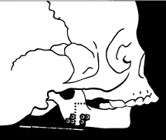
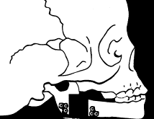
Schematic Pre and Post

Slide 15

Post Op NICU/PICU Protocol
KLS Screwdriver and Distraction Log Bedside
Begin distraction 24 hours post op
Plastic surgery to do first distraction, then RN vs family
Extubation TBD (max swelling) / Collaboration CF, NICU, HNS
Feeding attempts begin early post extubation
Plastic surgery to monitor post op via PA or pictures virtually
Distraction usually lasts 16 days/2 weeks (1.8 mm/day for 30 mm)
Biweekly HCO3 (chemistry vs CBG) until normal
Repeat sleep study after distraction complete
Discharge after when no positional desaturations and oral feeding ok
Apnea monitor generally not necessary (depending on PSG results)

Slide 16
During Distraction
Pain management
First few days IV, then Tylenol, then nothing before distraction
Antibiotic ointment around pin sites with each distraction
Keep Log of distance distracted
Things to watch for:
Pin site infections (common)
Asymmetry of the jaw (common)
Lack of advancement of the jaw
Maxillo-mandibular discrepancy
Continued poor feeding

Slide 17
General Pediatric Care
After mandibular distraction, treat baby as a normal baby with cleft palate
Will need special bottle, but no changes in solid food recommendations (other than will be messy)
Should follow in craniofacial clinic yearly for surgical and speech and orthodontic care
For PRS babies that are mild and not distracted, monitor for work of breathing, failure to thrive
Ophthalmology consult (usually done by craniofacial team)
Usually no other consults needed
Stickler syndrome

Slide 18
SCPMG Protocol
Development of a regional standardized care plan
Regional craniofacial management
Prospective IRB study with Dennis Hwang
Would like input from NICU and peds MD’s and RN’s
Will support KPCCN efforts and regional care

Slide 19
Conclusion
Pierre Robin leads to respiratory distress of varying degrees
Requires a comprehensive multidisciplinary team approach
Work up for management includes:
Sleep study
ABG/CBG
Consults to Craniofacial Surgery
Feeding issues may indicate need for intervention
Mandibular distraction is a viable alternative to tracheostomy and conservative treatment

