Slide 1

Bubble CPAP in the NICU
Fu-Sheng Chou | Michael Doti
Kaiser Permanente Riverside Medical Center

Slide 2
Nasal continuous positive airway pressure (NCPAP)
Noninvasive
Maintains lung volume (functional residual capacity, FRC)
Reduce the need for intubation
Reducing morbidities associated with mechanical ventilation

Slide 3
Pressure = Flow x Resistance

Slide 4
Ventilator-derived NCPAP (V-NCPAP)
Use both flow and resistance (valve) to generate desired pressure
CPAP level is maintained at the distal expiratory-limb orifice
Adjusts to keep the delivered CPAP at the desired level

Slide 5
Bubble NCPAP (B-NCPAP)
Introduced in the 1970’s
Flow is also constant
Expiratory limb of the CPAP tubing is immersed in an underwater chamber
Depth in centimeters equal to the ‘desired’ cmH₂O CPAP level
Flow of gas through the system creates bubbling in the chamber

Slide 6
Bubble NCPAP (B-NCPAP)
Favored by an institution reporting a low incidence of BPD
Improved gas exchange and lung recruitment during B-NCPAP, due to the high-frequency oscillatory content of the bubbling
More flow → more bubbling → better oscillation → better gas exchange
Lower FiO₂, lower length of stay, less invasive ventilation
(demonstration)

Slide 7
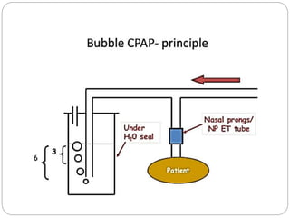
Bubble NCPAP (B-NCPAP)
Oscillatory effect from bubbling
Gas needs to get out, pressure built up to the depth of the tubing to overcome water pressure

Slide 8

How does bubble CPAP work?

Slide 9
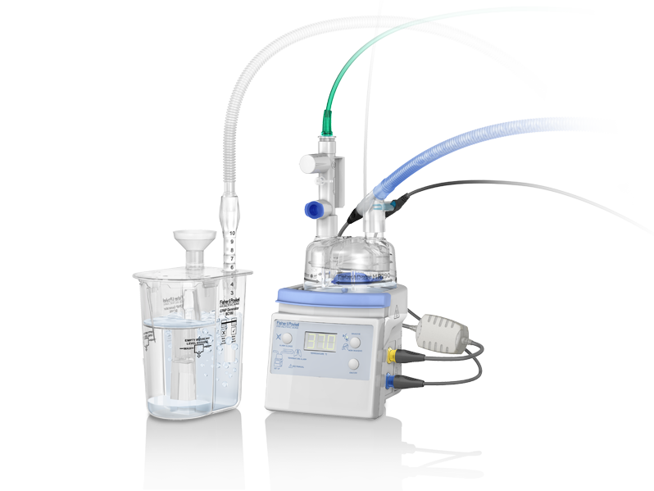
Fisher & Paykel bubble CPAP (bCPAP) system

Slide 10
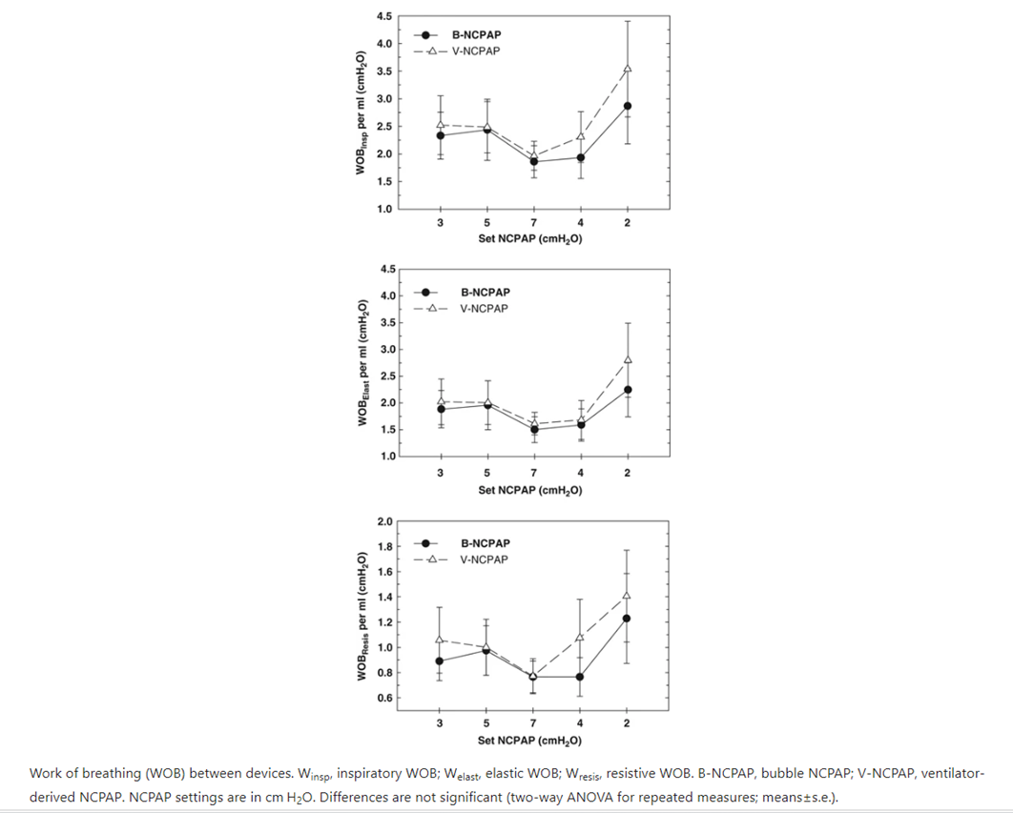
Work of breathing variance

Slide 11
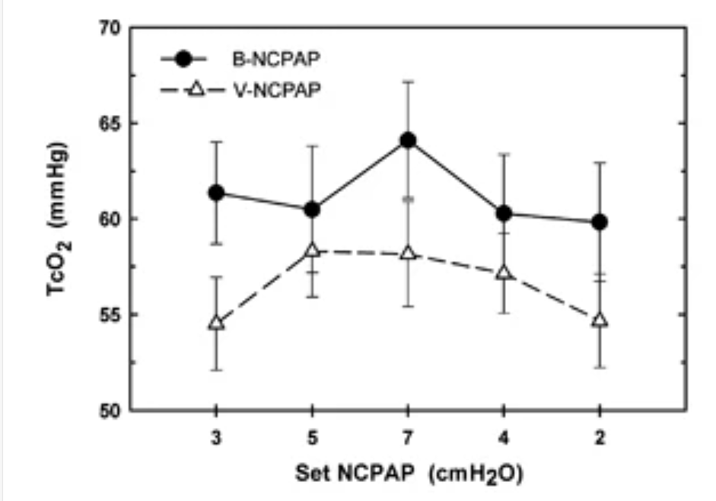
CO2 retention variance

Slide 12
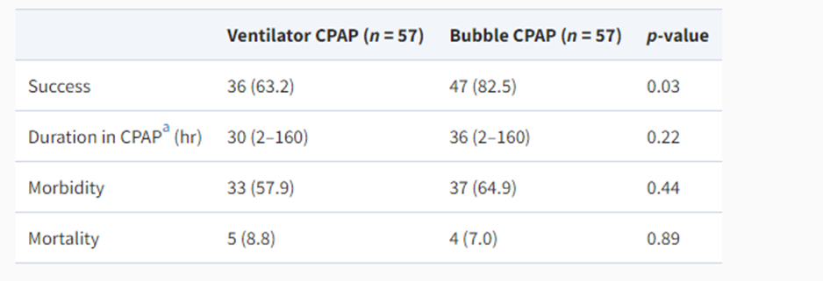
Outcomes
Success is defined as weaning off CPAP due to clinical improvement
Failure: FiO₂ > 60%, CPAP ≥ 8 cmH₂O, apnea requiring PPV, shock, intubation

Slide 13
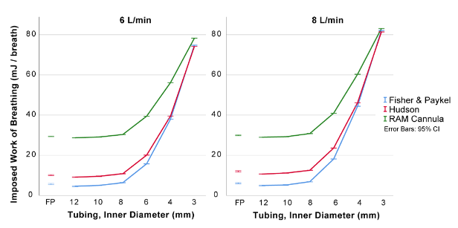
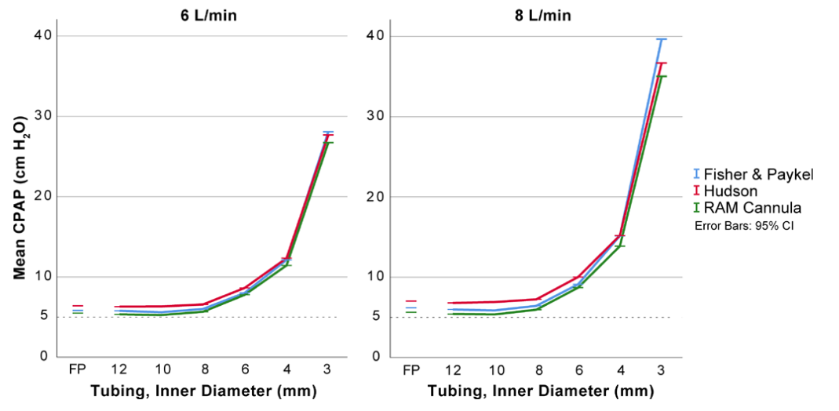
Factors affecting the success of B-NCPAP
Nasal interface
Nasal prong, nasal mask (closed, low resistance)
RAM Cannula (open, high-resistance; if no leak, significantly increased WOB)

Slide 14
Factors affecting the success of B-NCPAP
Monitoring and preventing nasal injury
Frequent assessment
Risk of losing FRC during assessment
Fixation of the nasal interface
Avoid lateral pressure, especially on the nasal septum

Slide 15
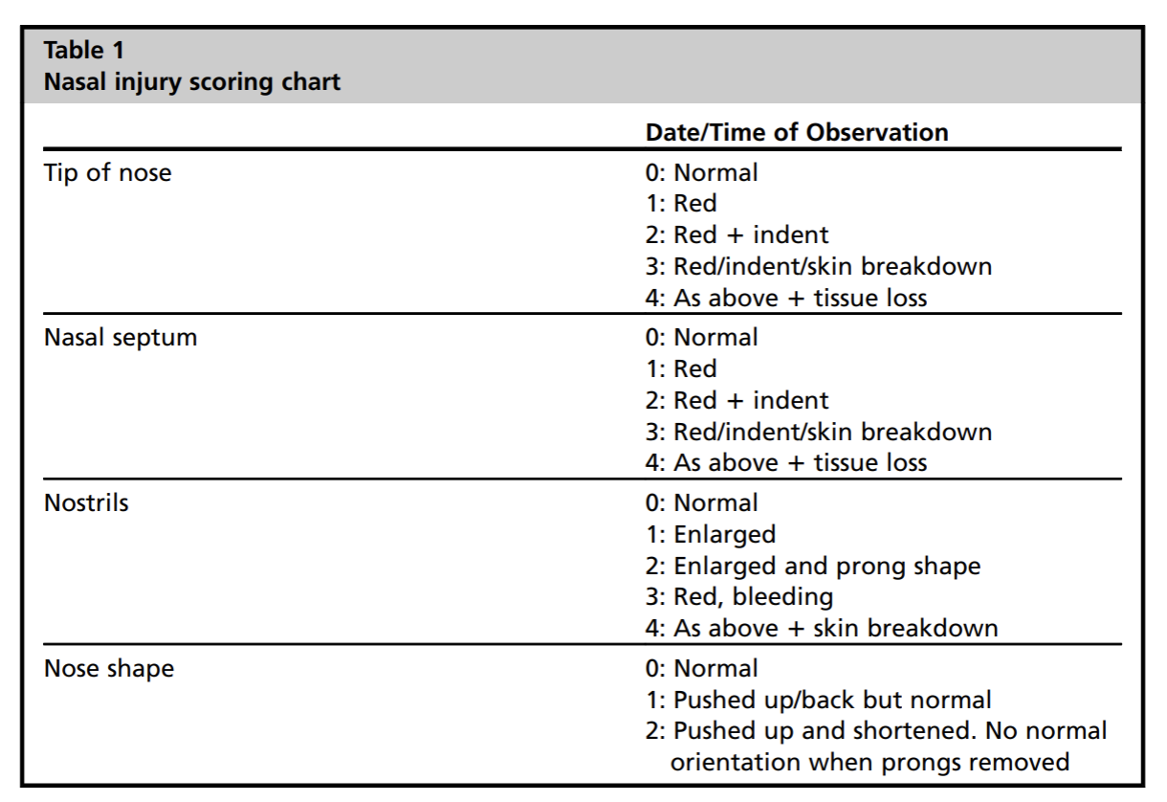
Nasal injury scoring chart

Slide 16
Factors affecting the success of B-NCPAP
Bubbling and system check
No flow, no bubbling
Tubing too deep because water builds up
Optimizing pressure delivery
Pacifier / chin strap
OG tube to vent

Slide 17
Compared to V-NCPAP, B-NCPAP does not…
Reduce mortality
Reduce pneumothorax
Reduce adverse neurodevelopmental outcomes
Reduce BPD

Slide 18
Q&A

